Slide 1
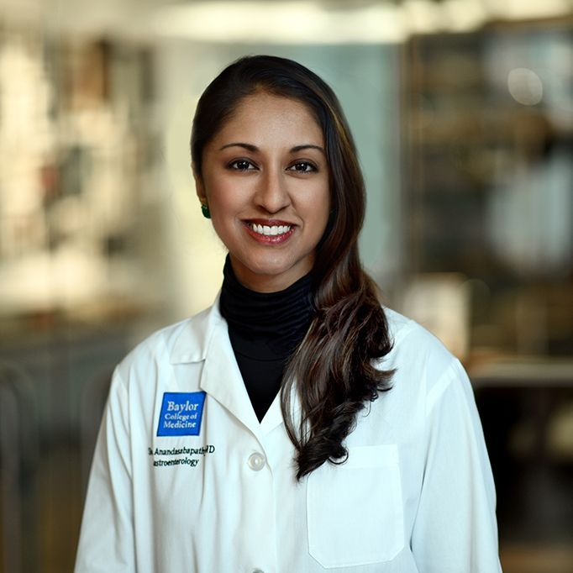
Sharmila Anandasabapathy, MD
Vice President, Baylor College of Medicine, Global Initiatives

Slide 2
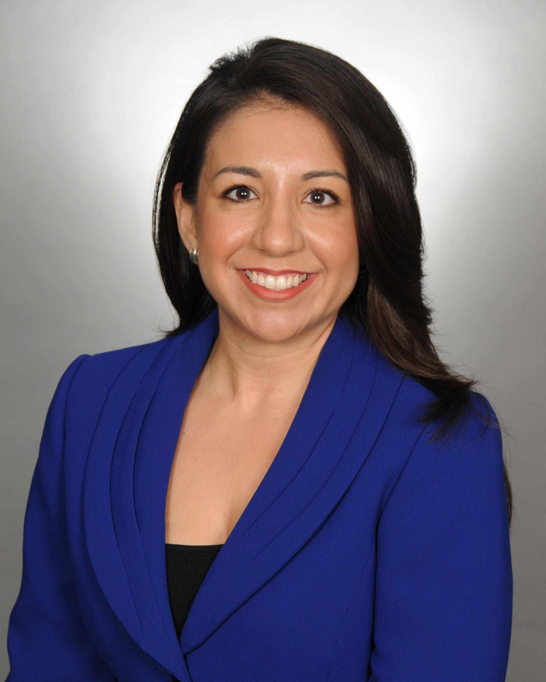
Veronica R. Chapa
Executive Director, Early Matters

Slide 3
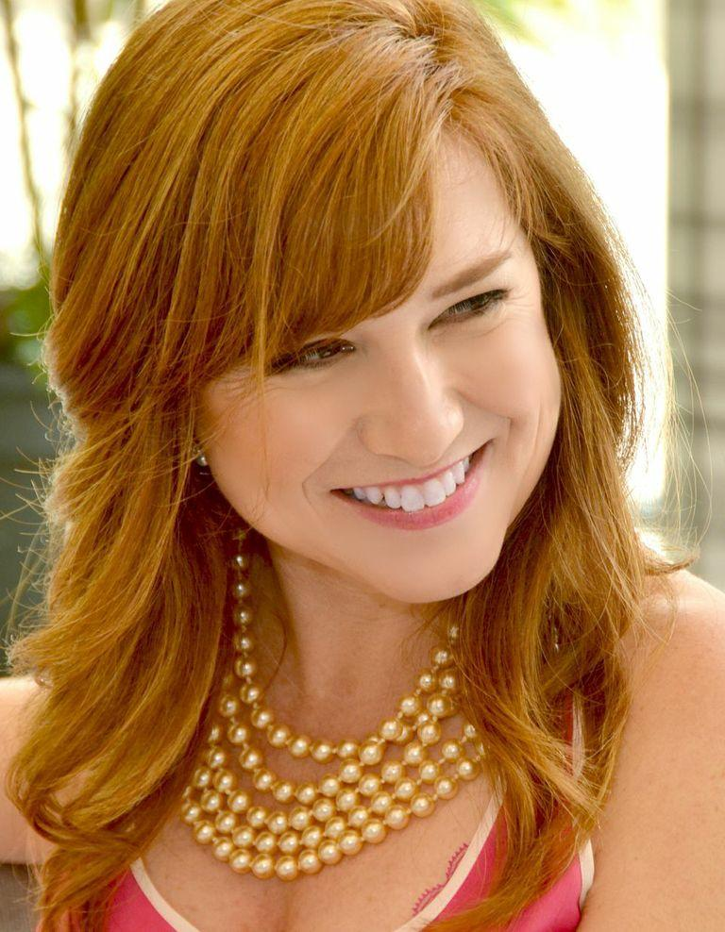
Donae Cangelosi Chramosta
Owner, The Vintage Contessa

Slide 4
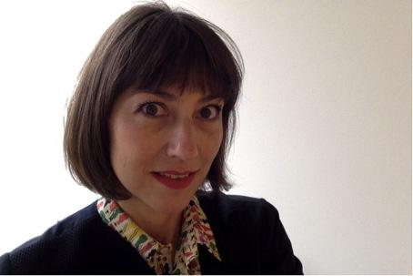
Sylvie Christophe
Cultural Attaché, French Embassy in the
United States- Cultural Services

Slide 5
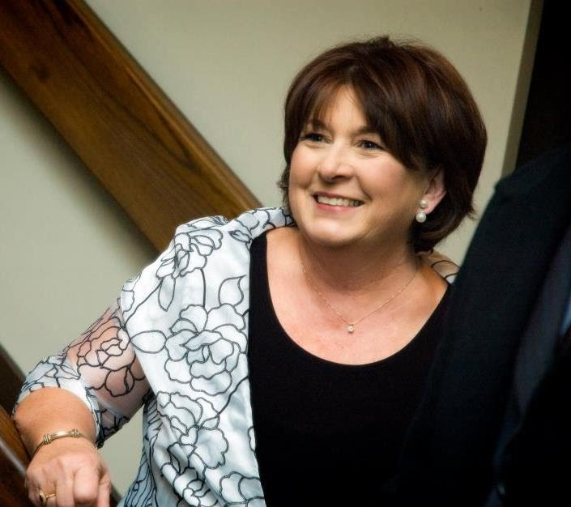
Jo Clem
Worldwide Advisor for Employee Development, Apache Corporation

Slide 6
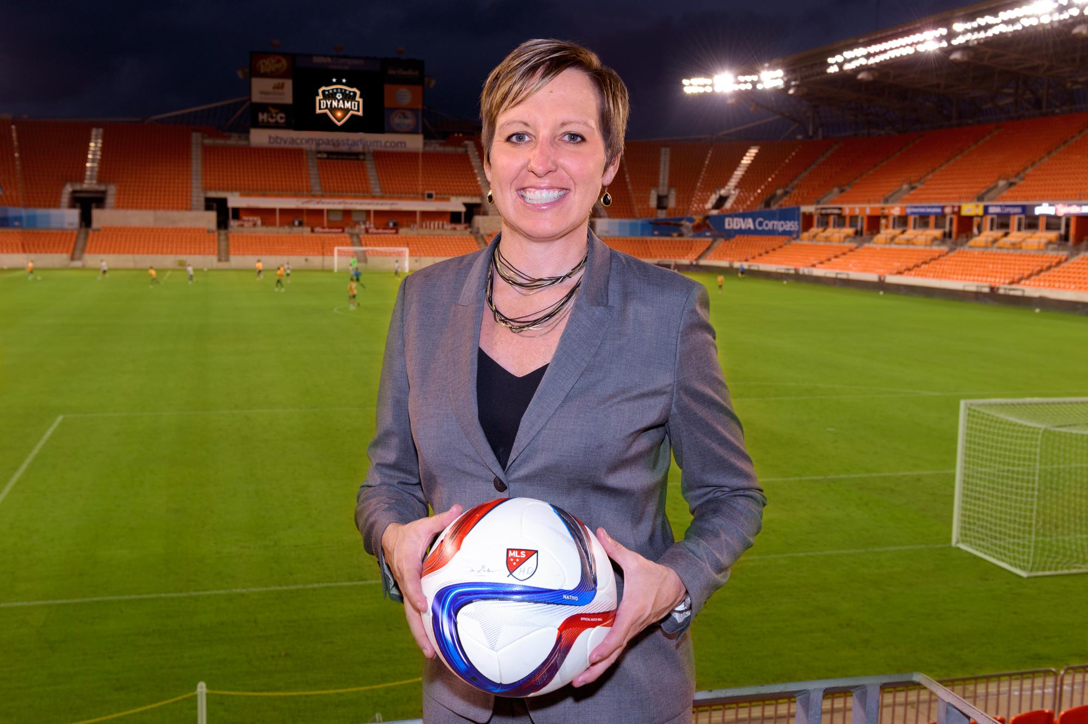
Amber Cox
VP & CMO, Houston Dynamo &
Houston Dash Soccer

Slide 7
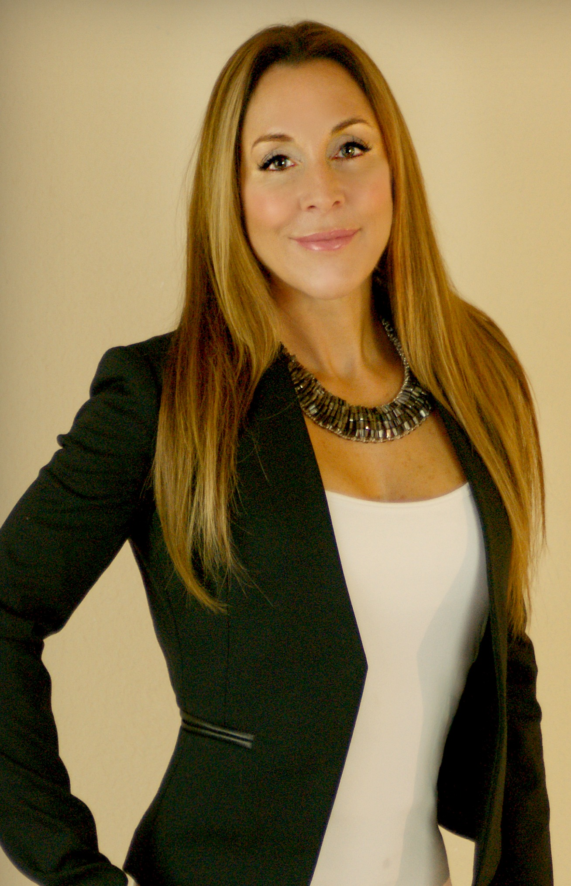
Katya Dow
Legal Program Director, UH Juvenile & Capital Advocacy Group

Slide 8
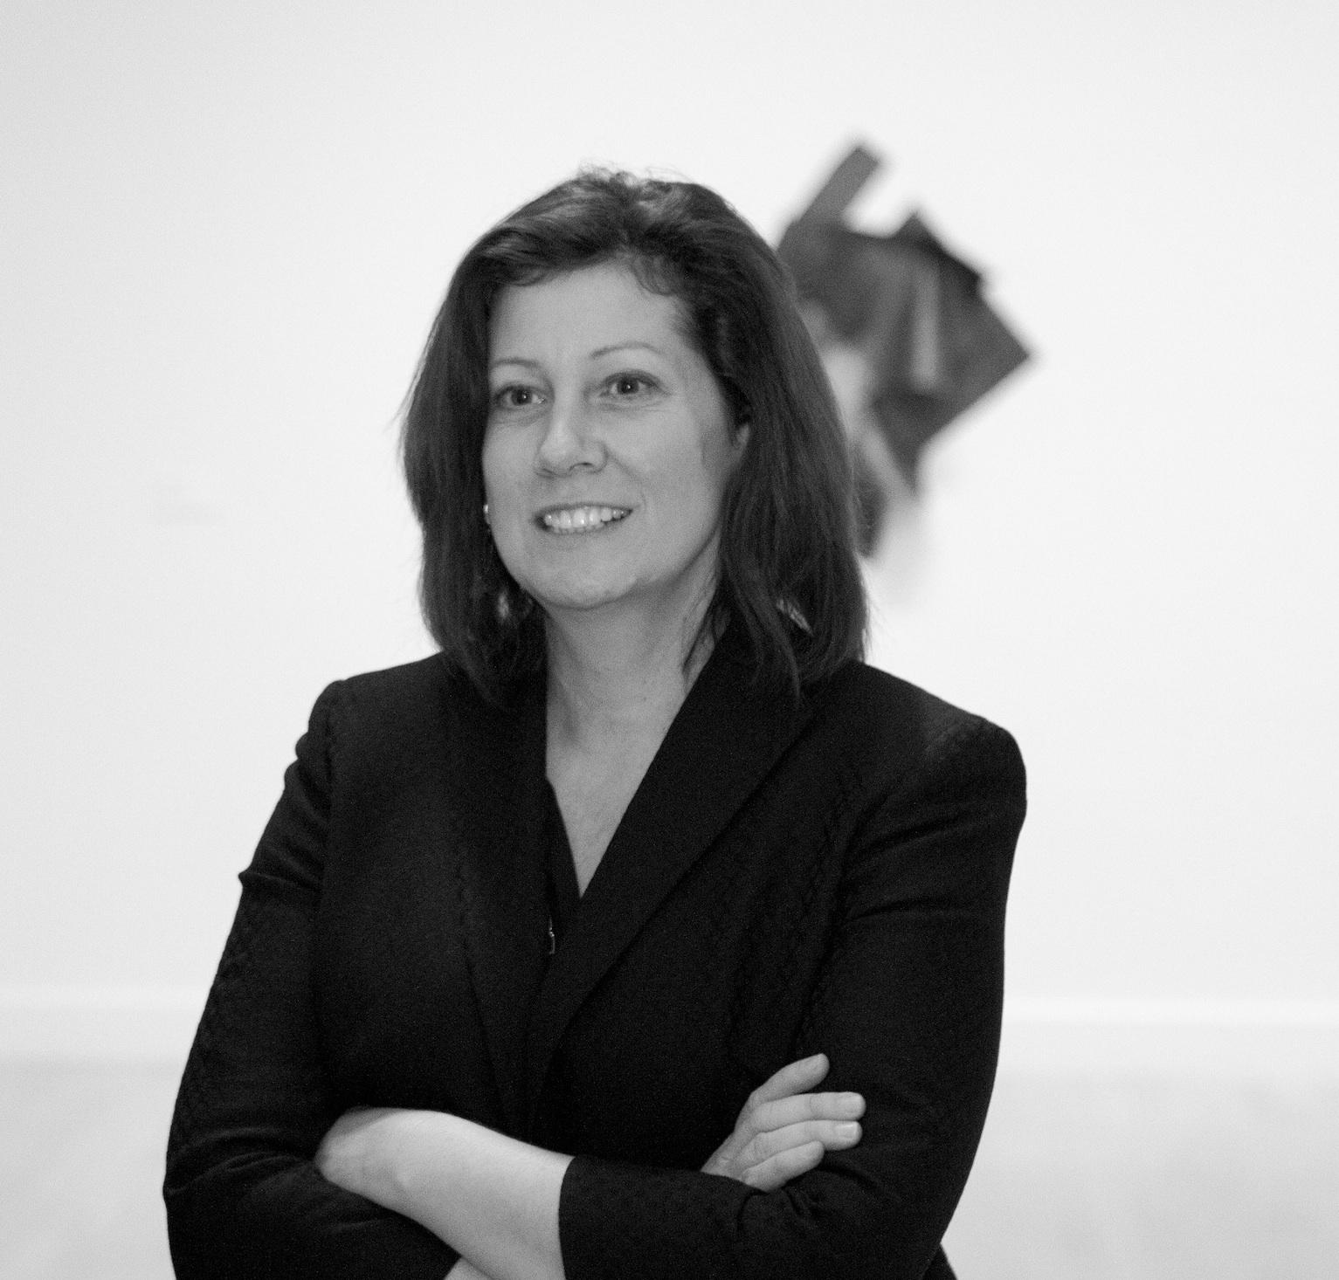
Xandra Eden
Executive Director & Chief Curator, DiverseWorks

Slide 9
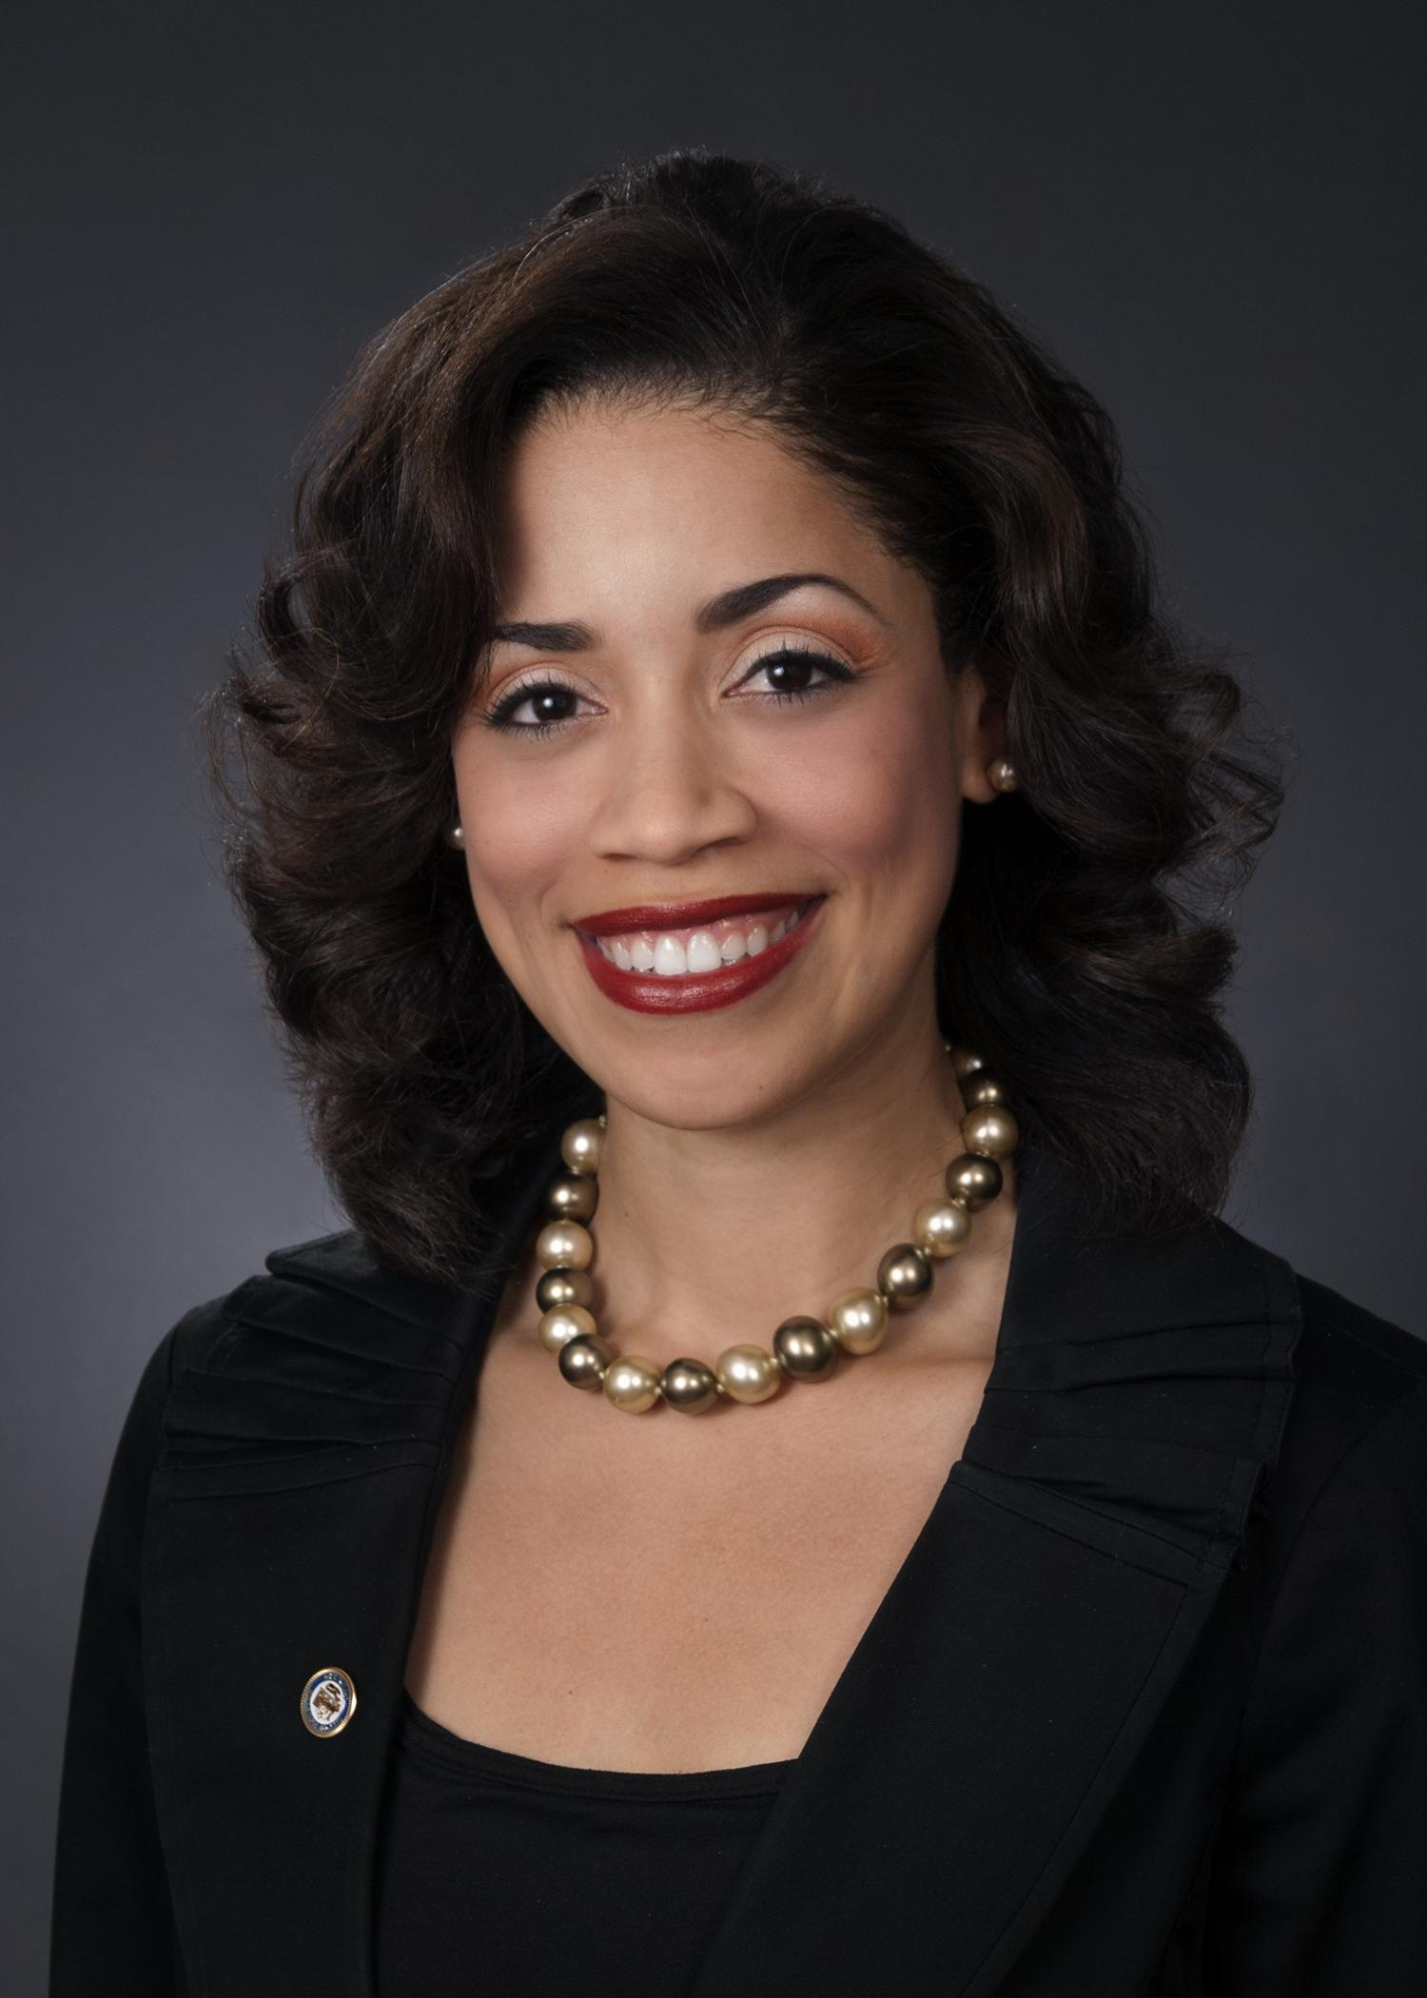
Amanda K. Edwards
Houston City Council Member,
At-Large Position 4

Slide 10
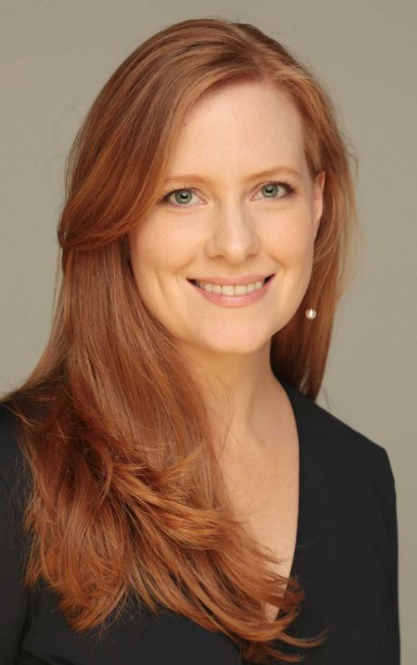
Lisa Falkenberg
Metro Columnist, Houston Chronicle
& 2015 Pulitzer Prize Winner

Slide 11
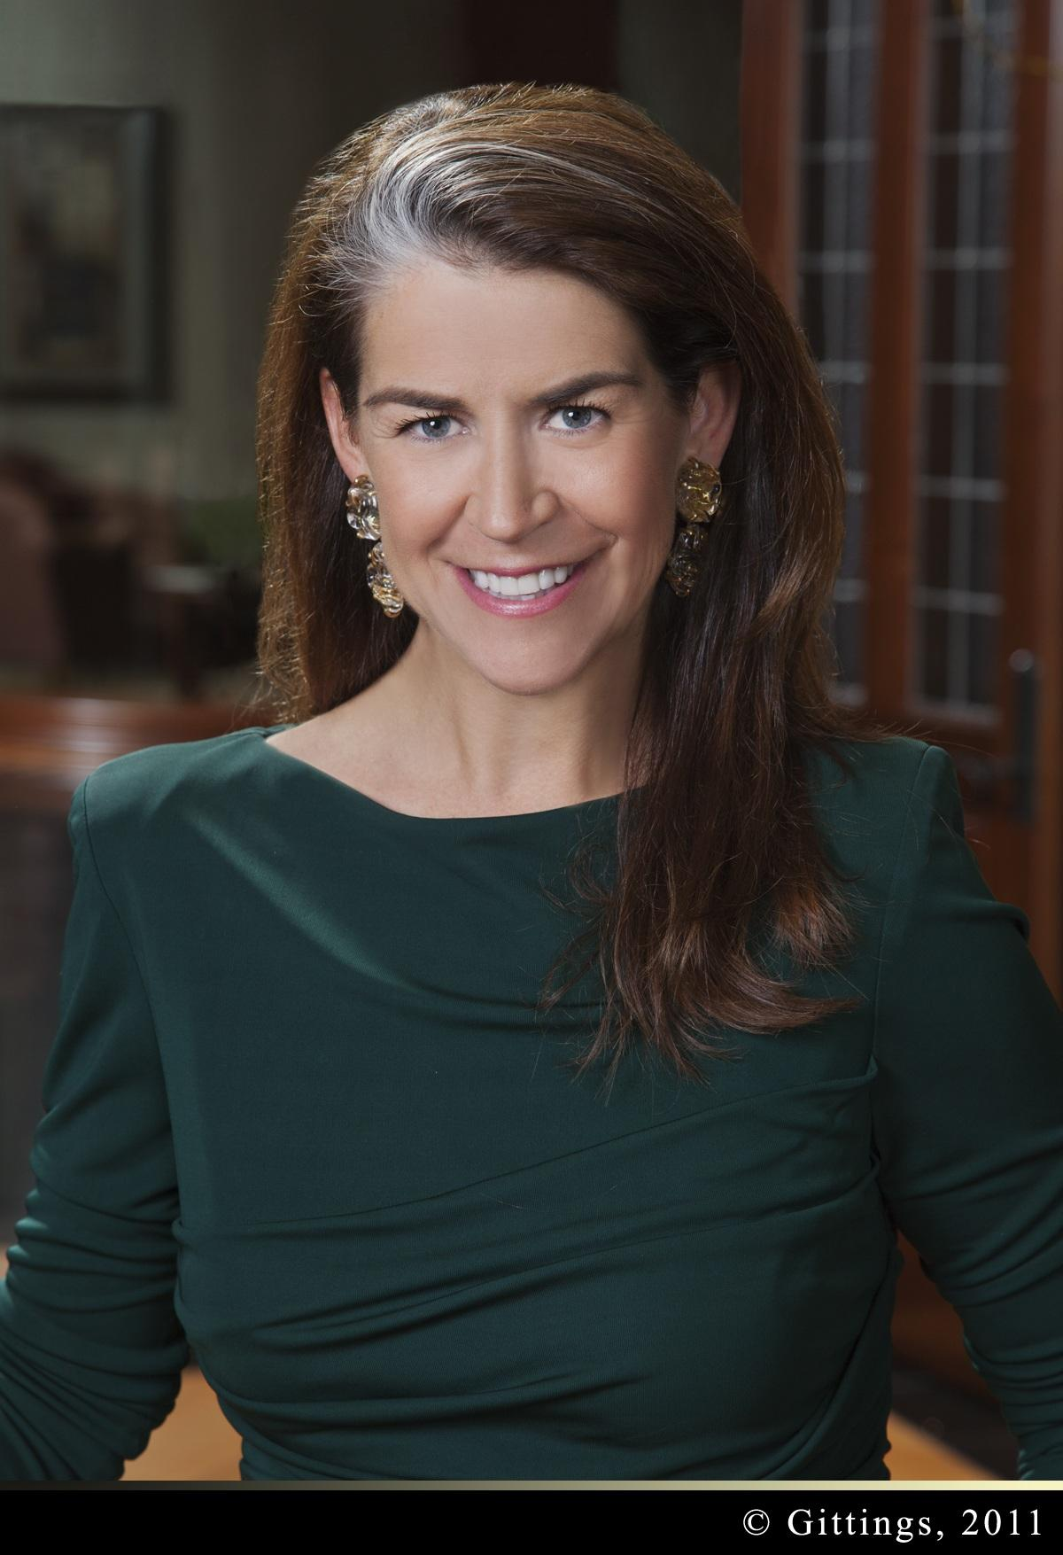
Stacey Gillman Wimbish
President, Gillman Companies

Slide 12
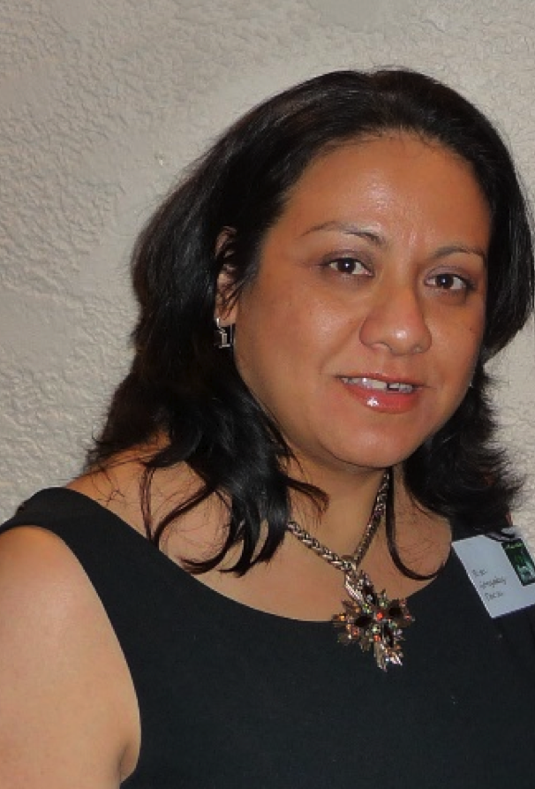
Rosa González-Décou
Multilingual Programs Outreach Worker, HISD

Slide 13
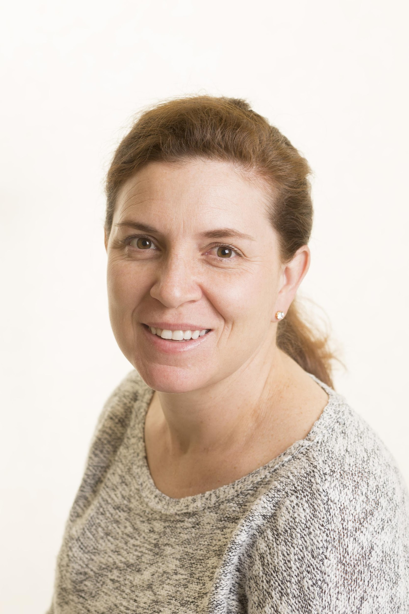
Nikki Greenspan
Pilot, United Airlines

Slide 14
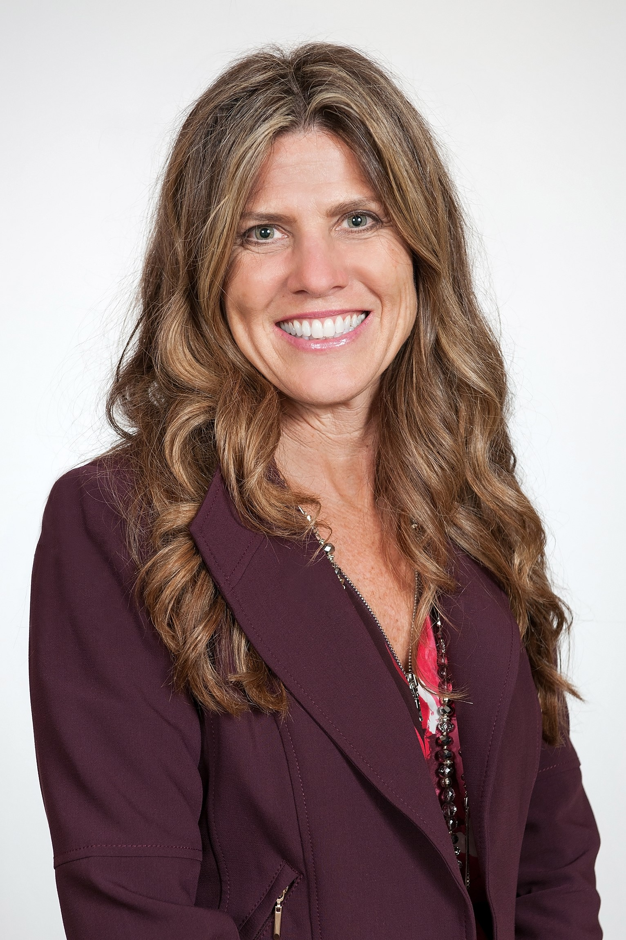
Joy Hall
Marine Training Director, ConocoPhillips

Slide 15
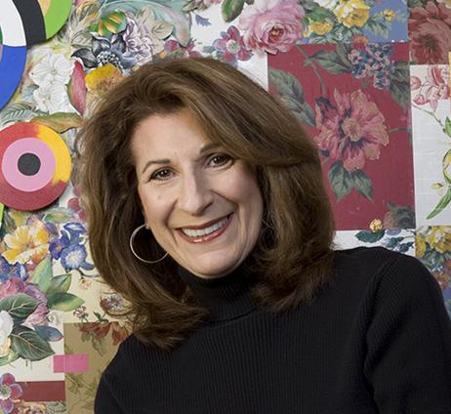
Roberta Harris
Artist & Owner, Roberta Harris Studio

Slide 16
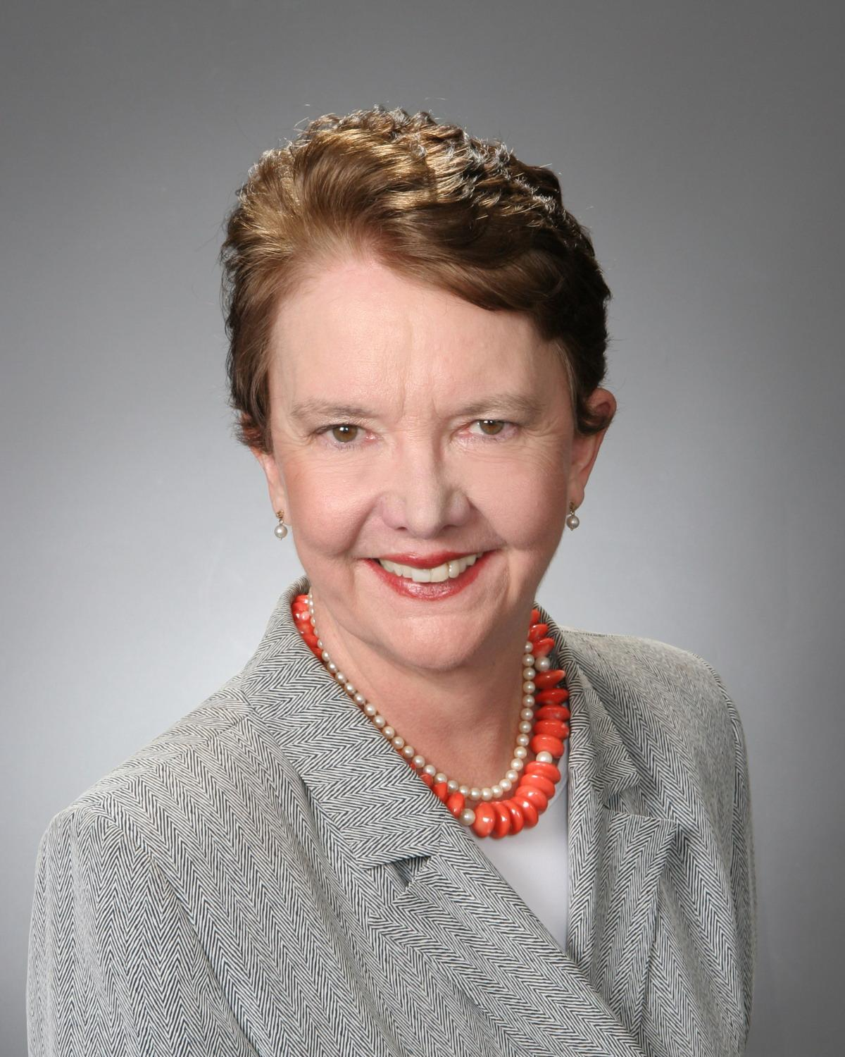
Justice Laura Carter Higley
1st Court of Appeals

Slide 17
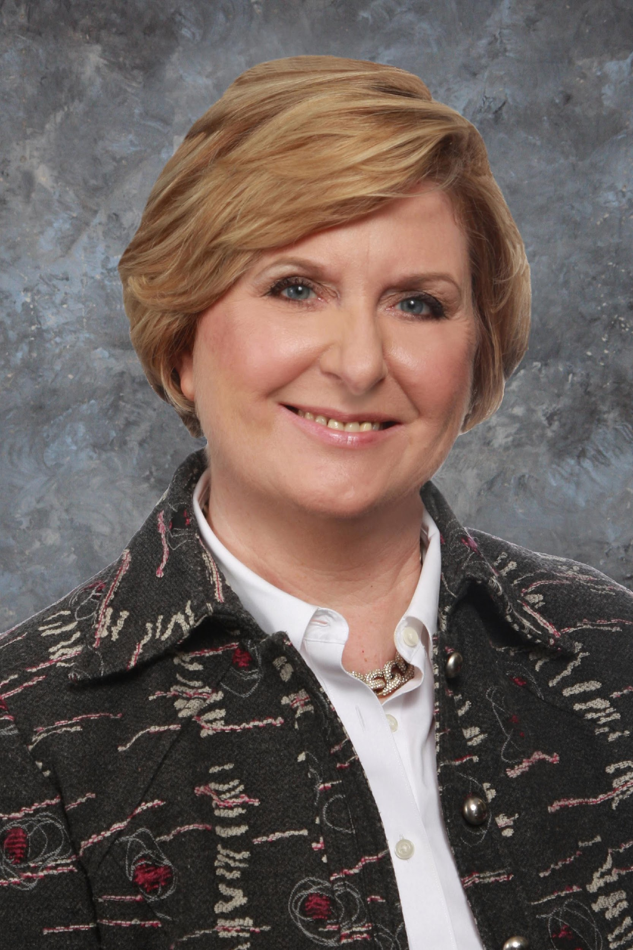
Andrea Johnson
Director, Kane Russell Coleman & Logan PC

Slide 18
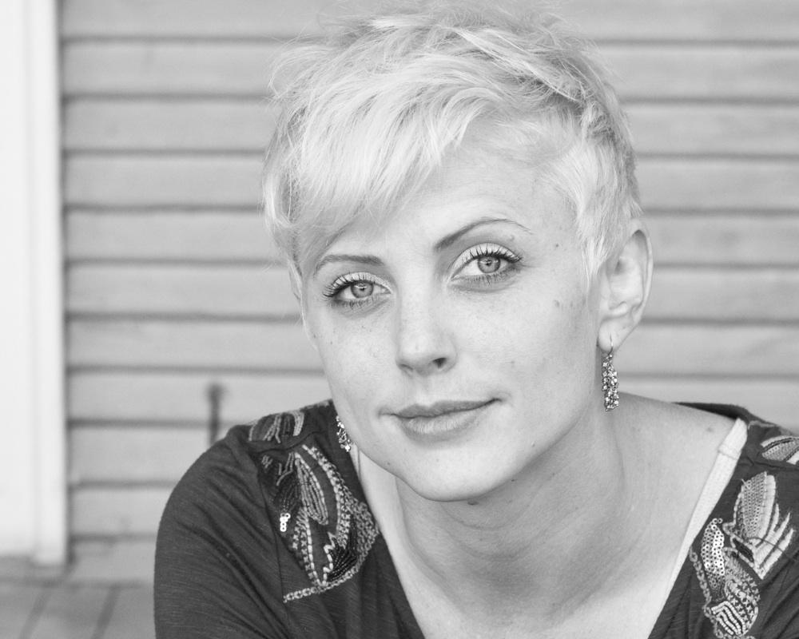
Lacy M. Johnson
Writer; Author of The Other Side

Slide 19
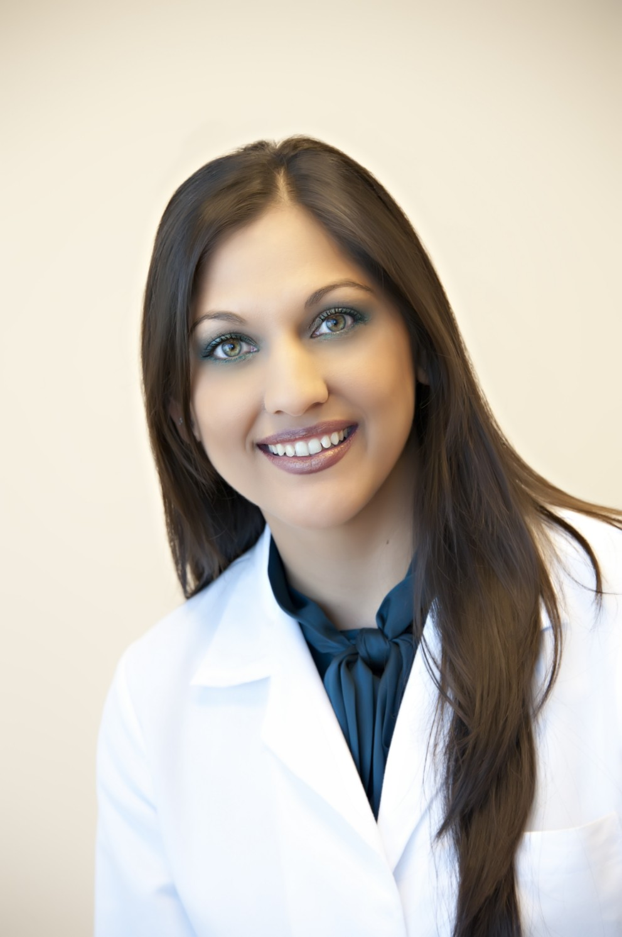
Sippi Khurana, MD
Owner & Physician, Allergy & Rheumatology Specialists of Houston

Slide 20
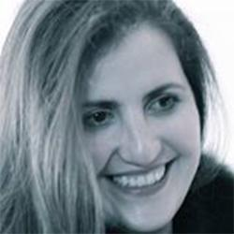
Farah Killidar
CEO, World Affairs Council of Greater Houston

Slide 21
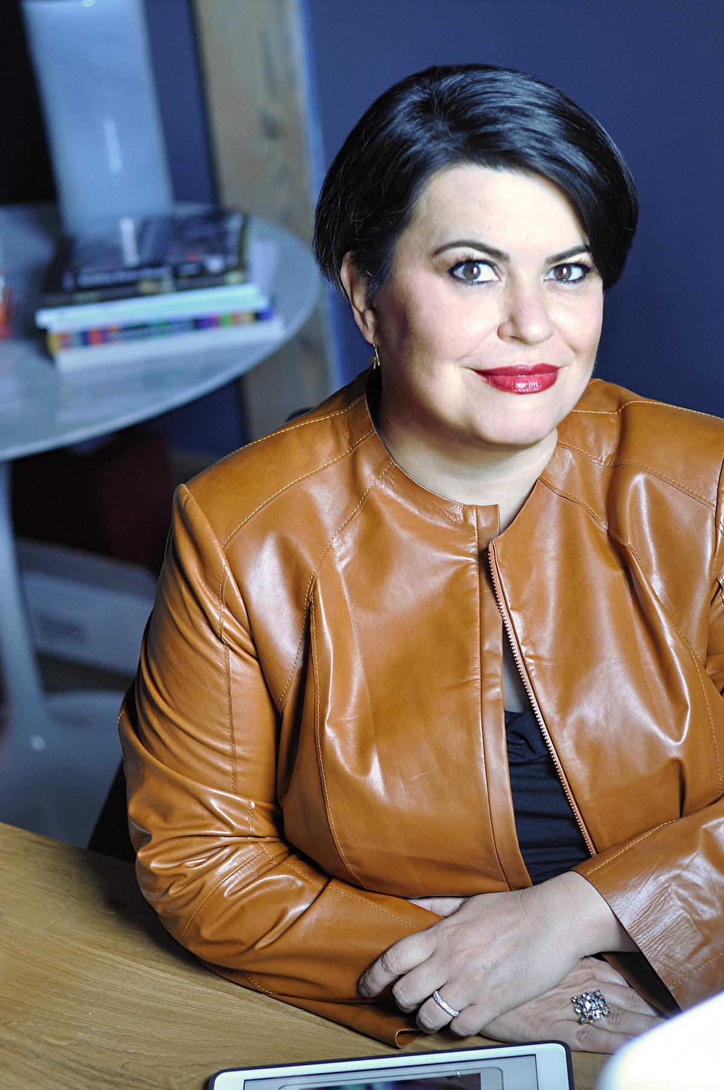
Shannon Langrand
Founder & CEO, Langrand & Company

Slide 22
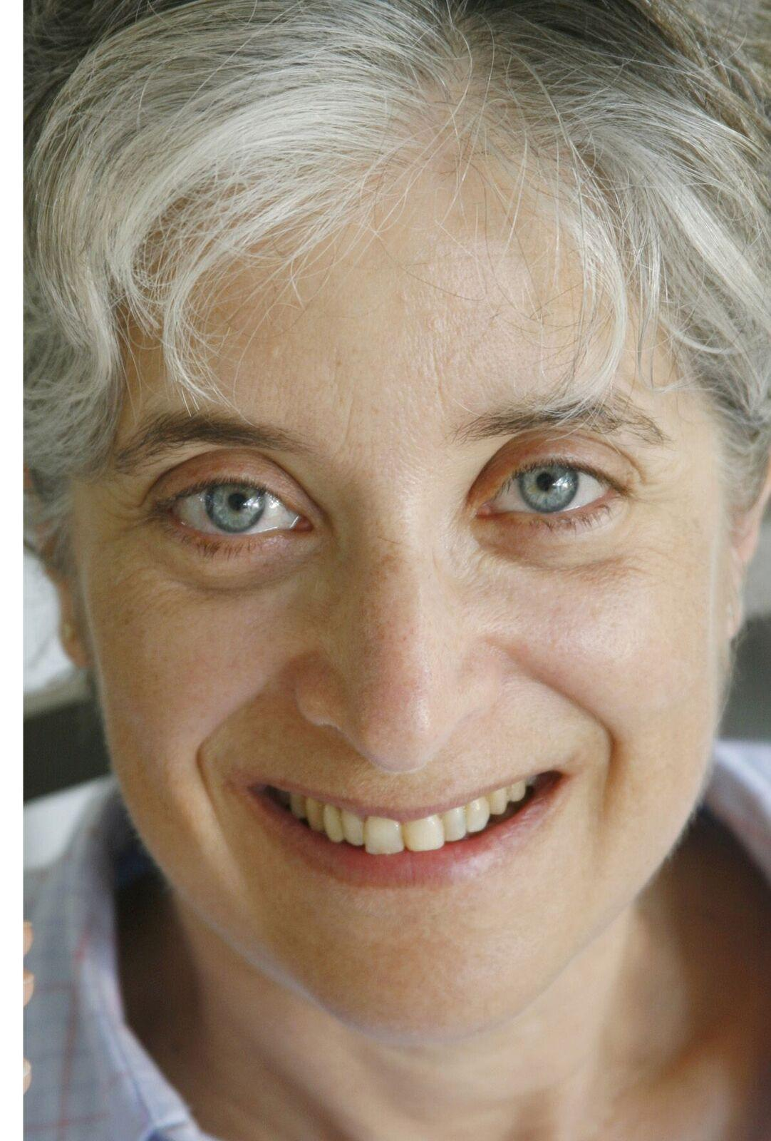
Leah Lax
Writer; Author of Uncovered

Slide 23
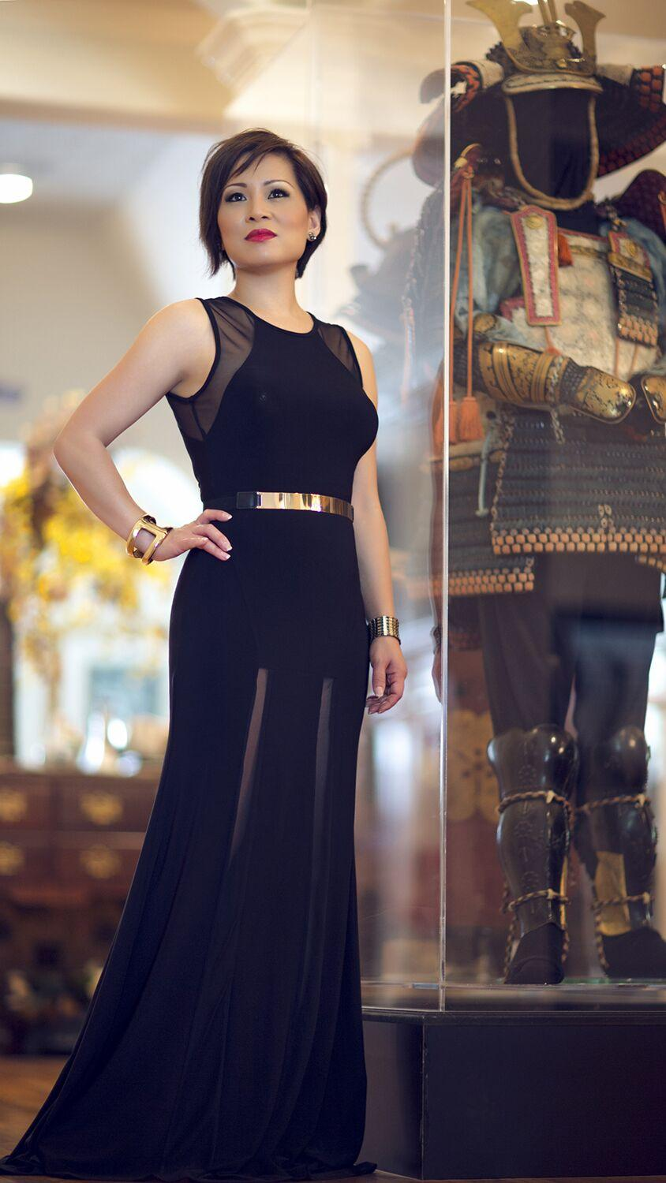
Deneice Leigh
Owner & Chairman, Anime Matsuri Convention

Slide 24
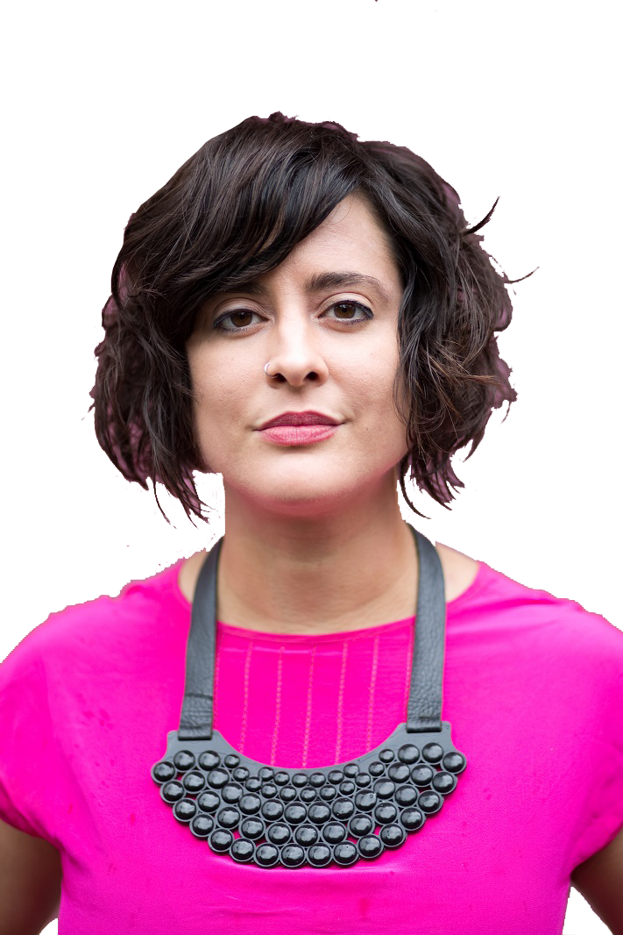
Sarah Luna, PhD
WGSS Postdoctoral Fellow, UH

Slide 25
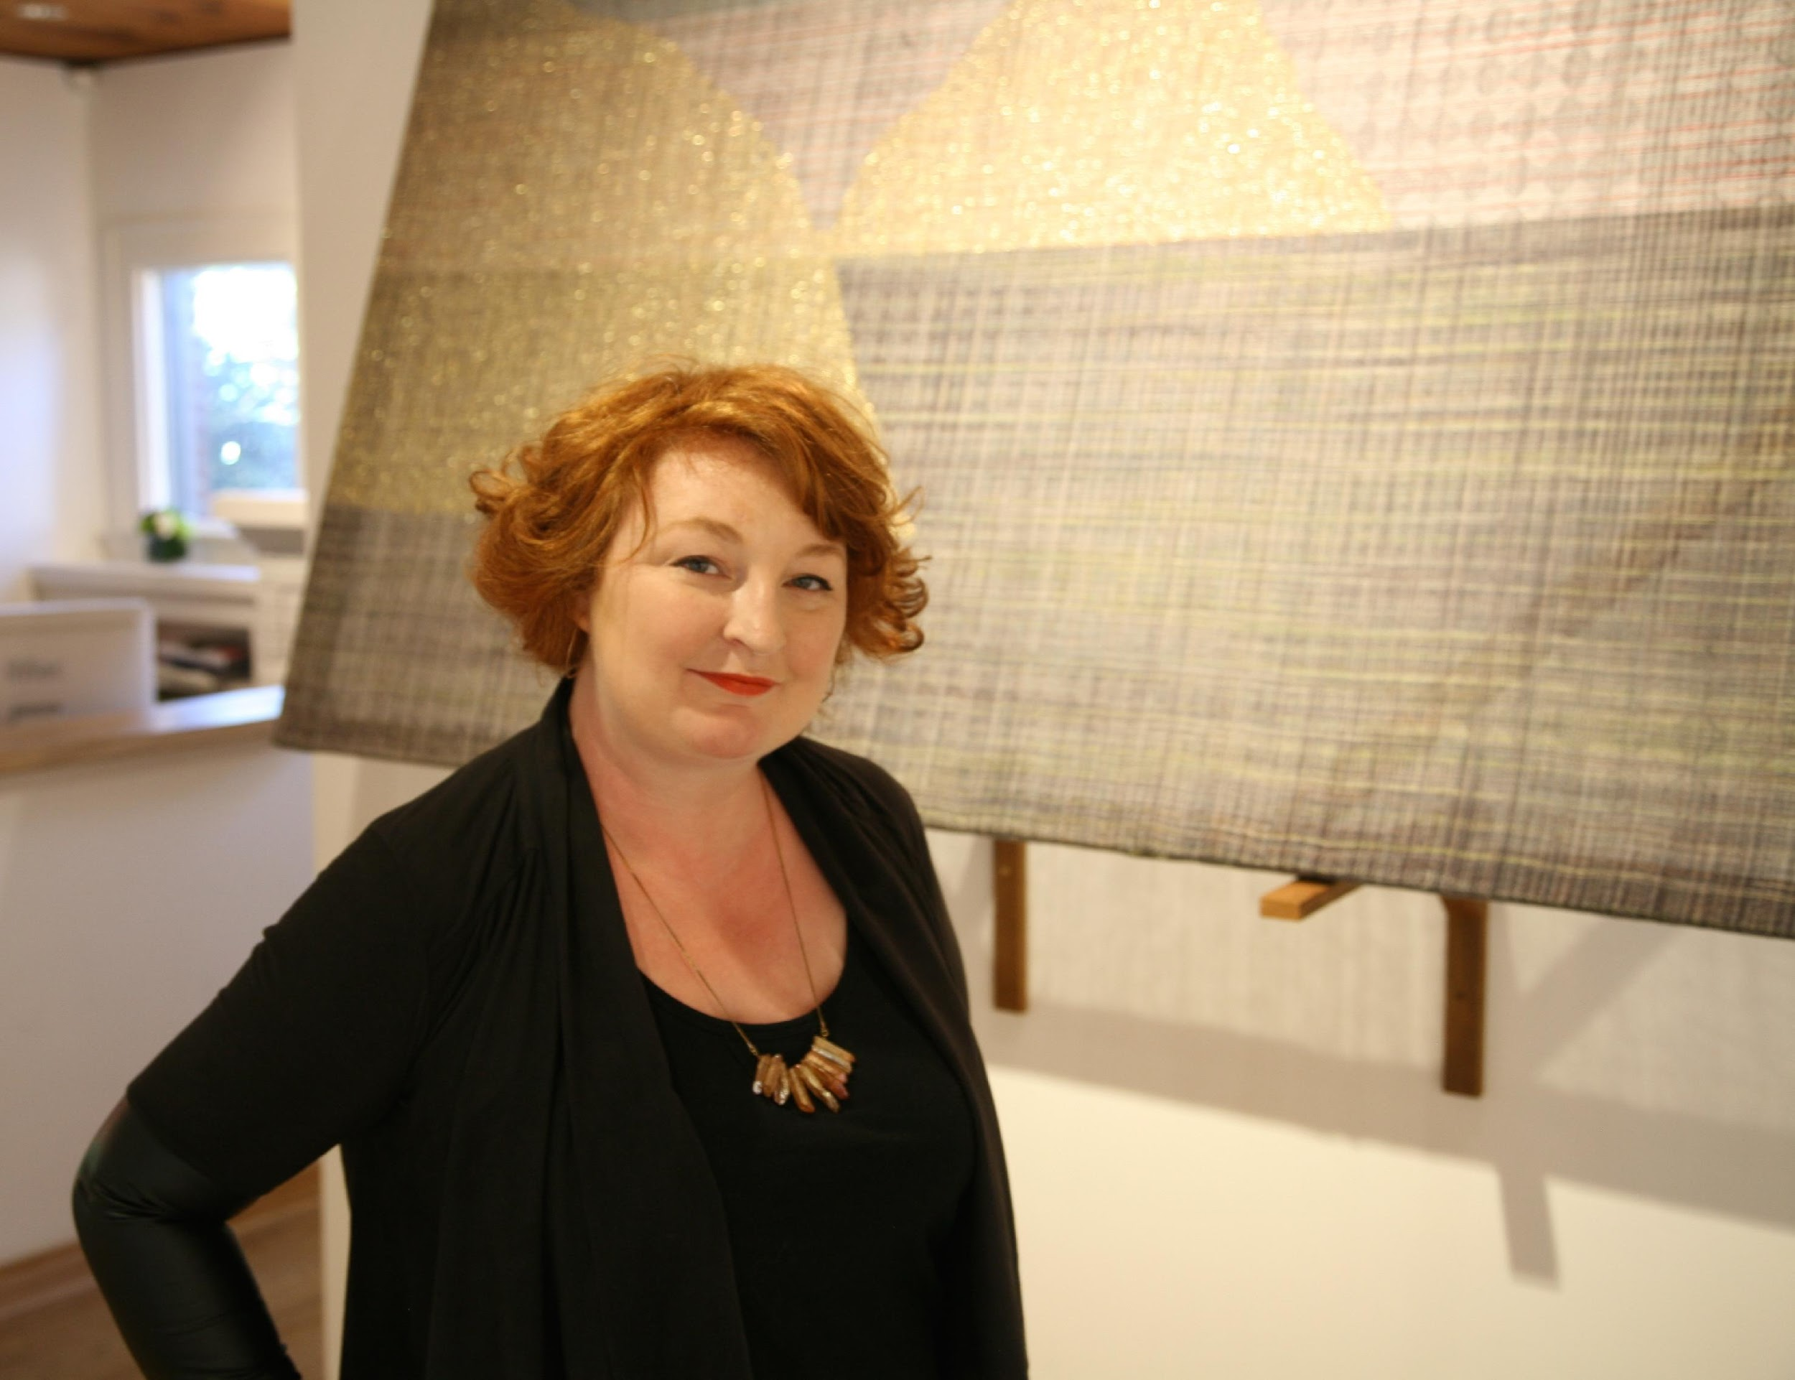
Lynne McCabe
Director, She Works Flexible Gallery

Slide 26
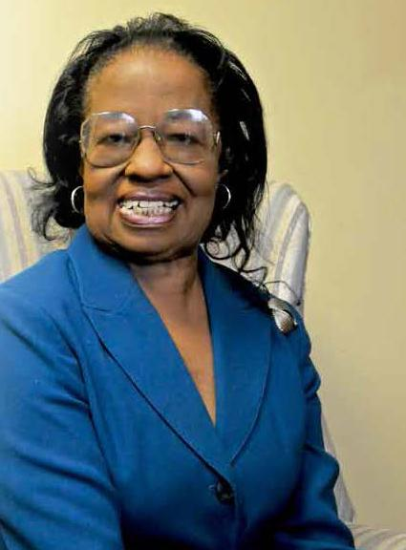
Teddy McDavid, EdD
President, Old Spanish Trail Community Board

Slide 27
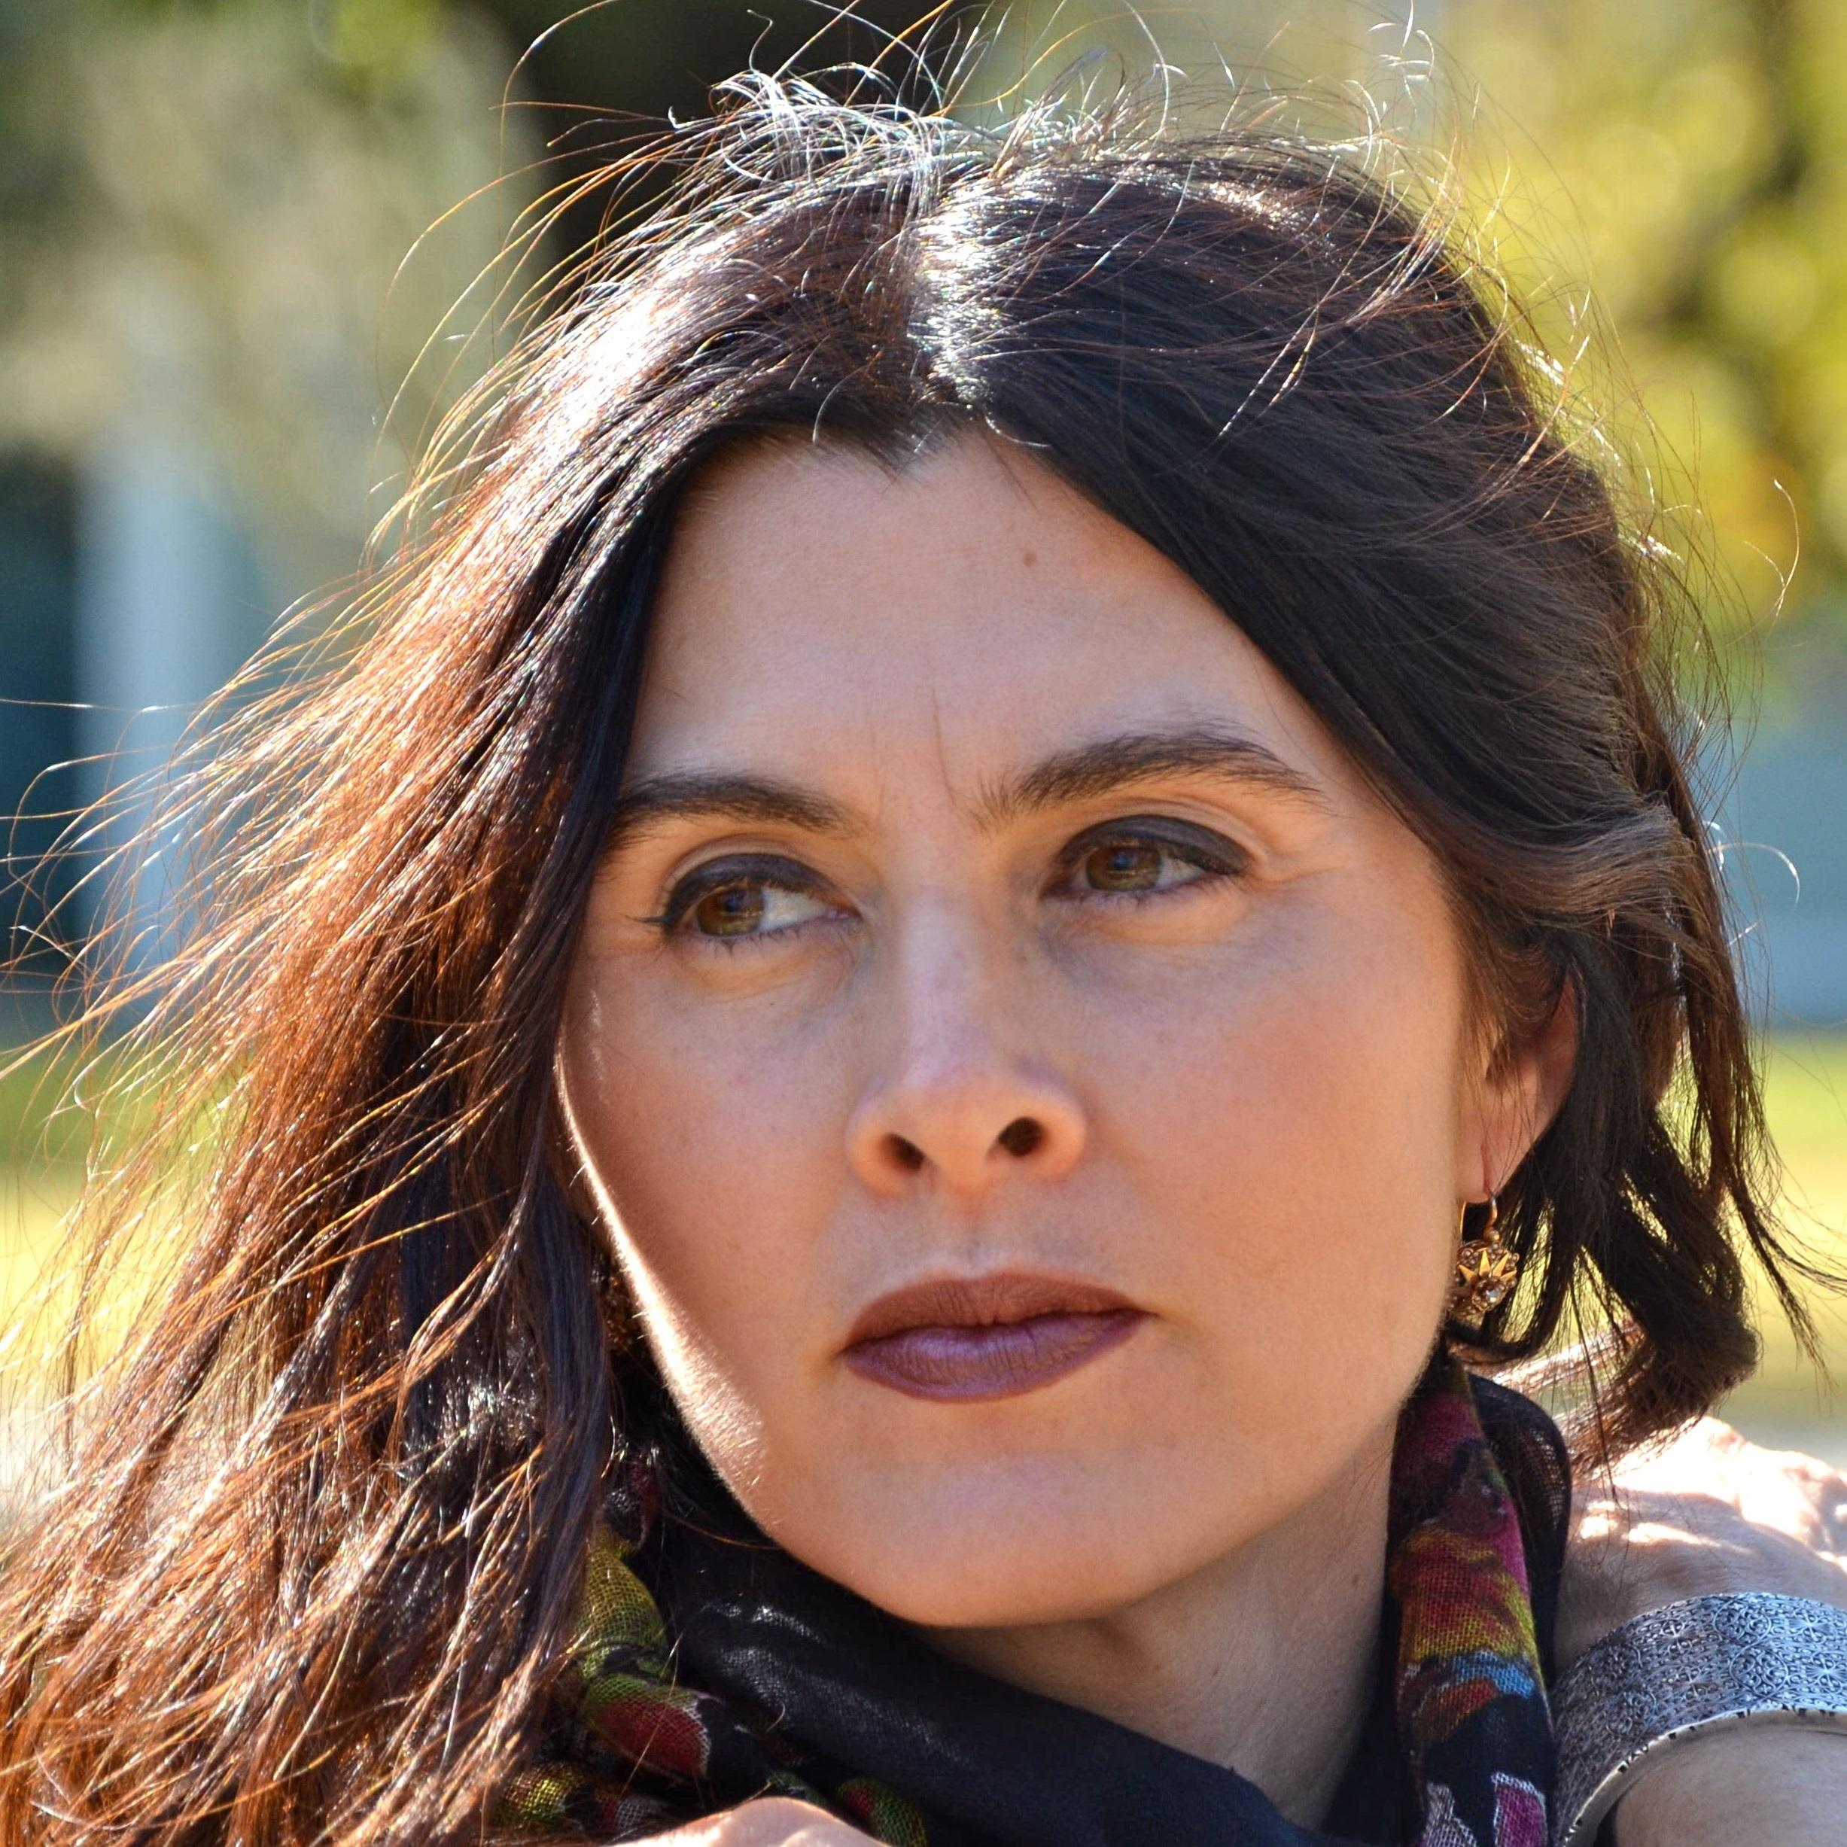
Kimberly Meyer
Author, The Book of Wanderings;
Visiting Assistant Professor, UH Honors College

Slide 28
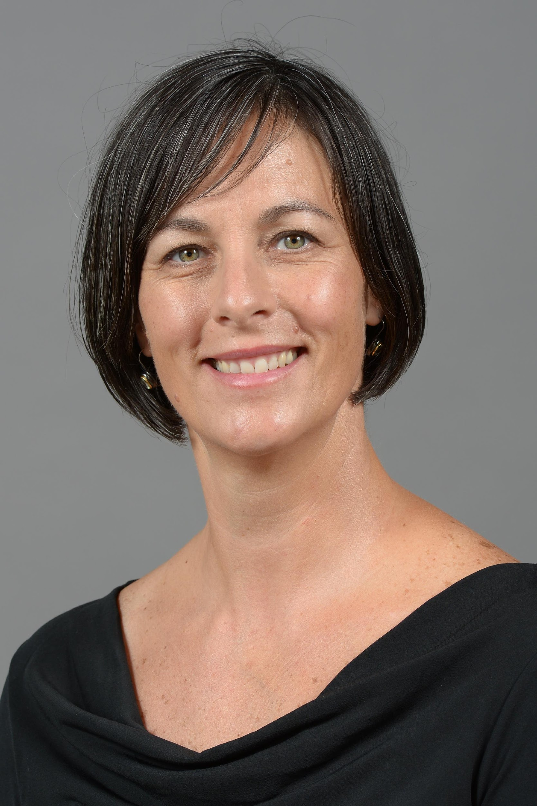
Susana R. Monteverde
Owner, SuMo Art

Slide 29
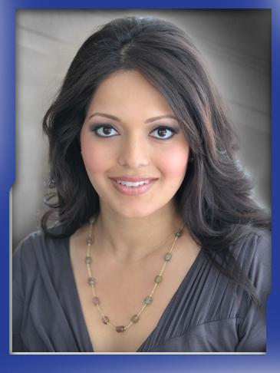
Rekha Muddaraj
News Anchor, KHOU

Slide 30
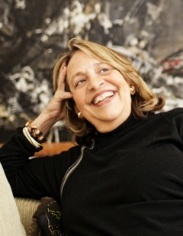
Marilyn Oshman
Founder & Chairman, Orange Show

Slide 31
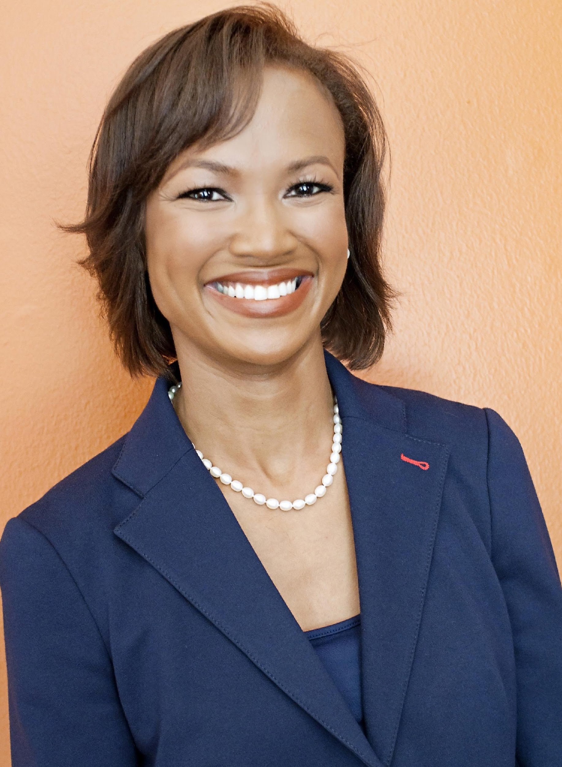
Precious Williams Owodunni
President, Mountaintop Consulting

Slide 32
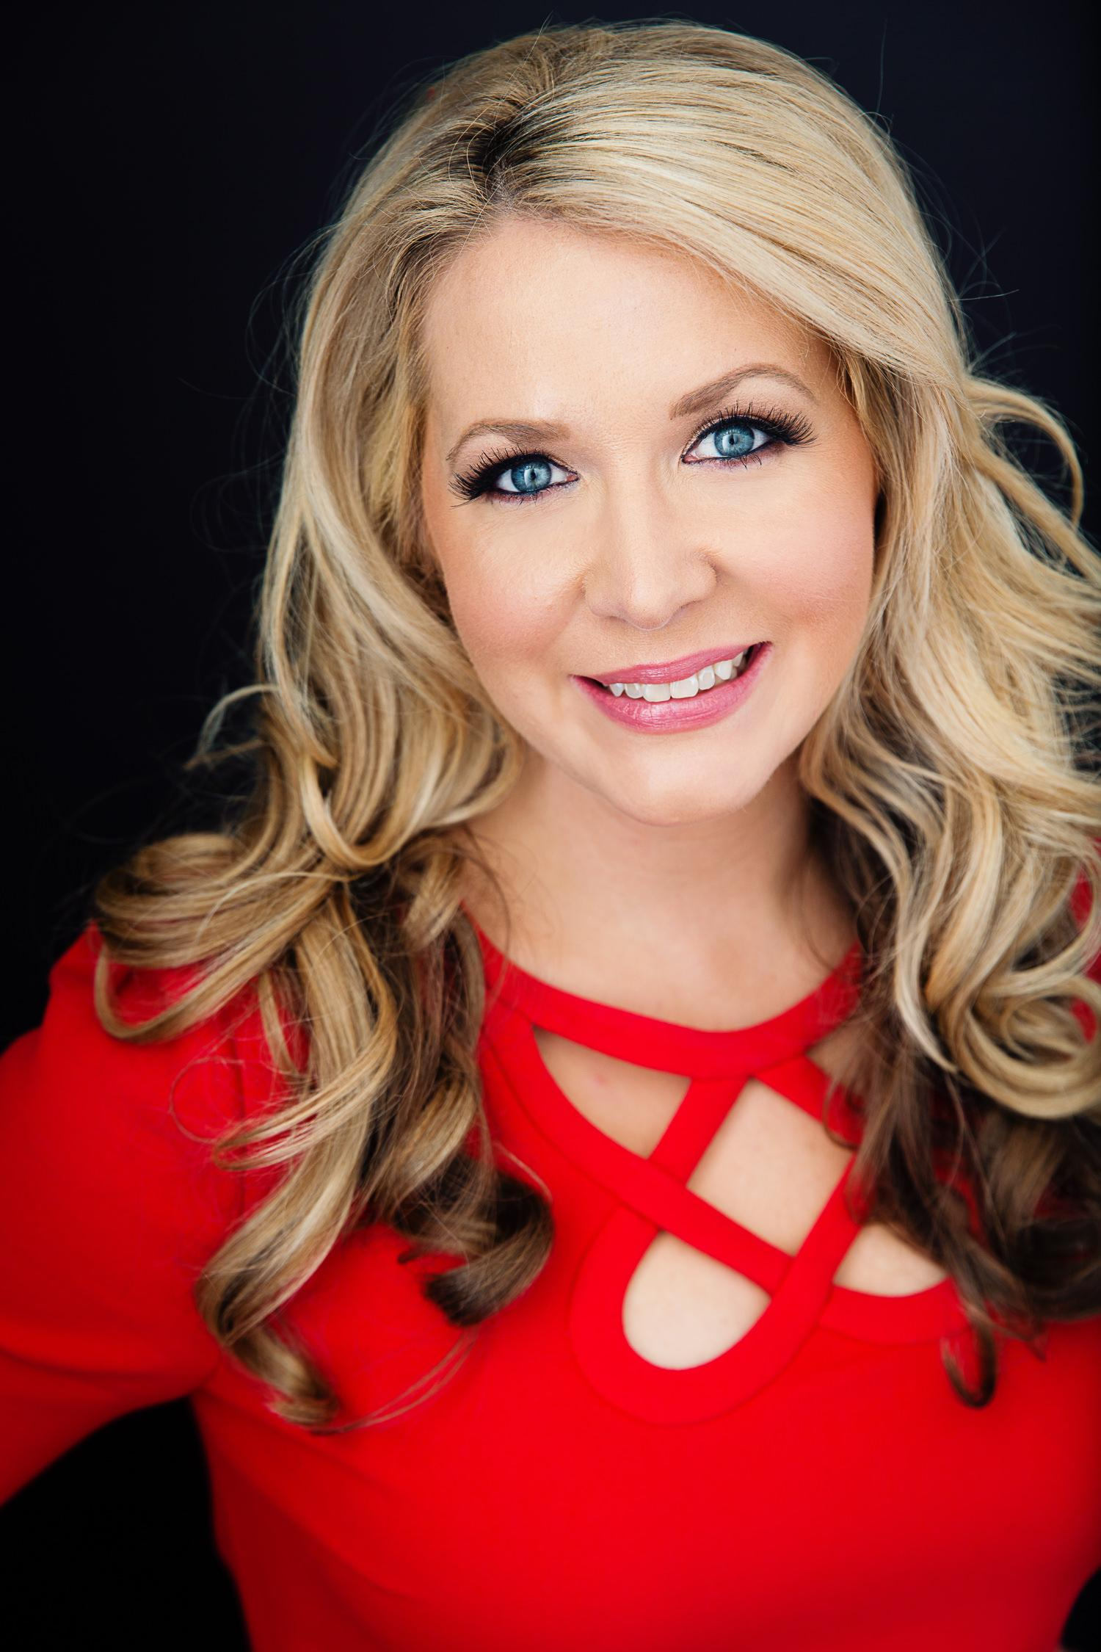
Misti Pace-Krahl
Founder, The Mommie Series

Slide 33
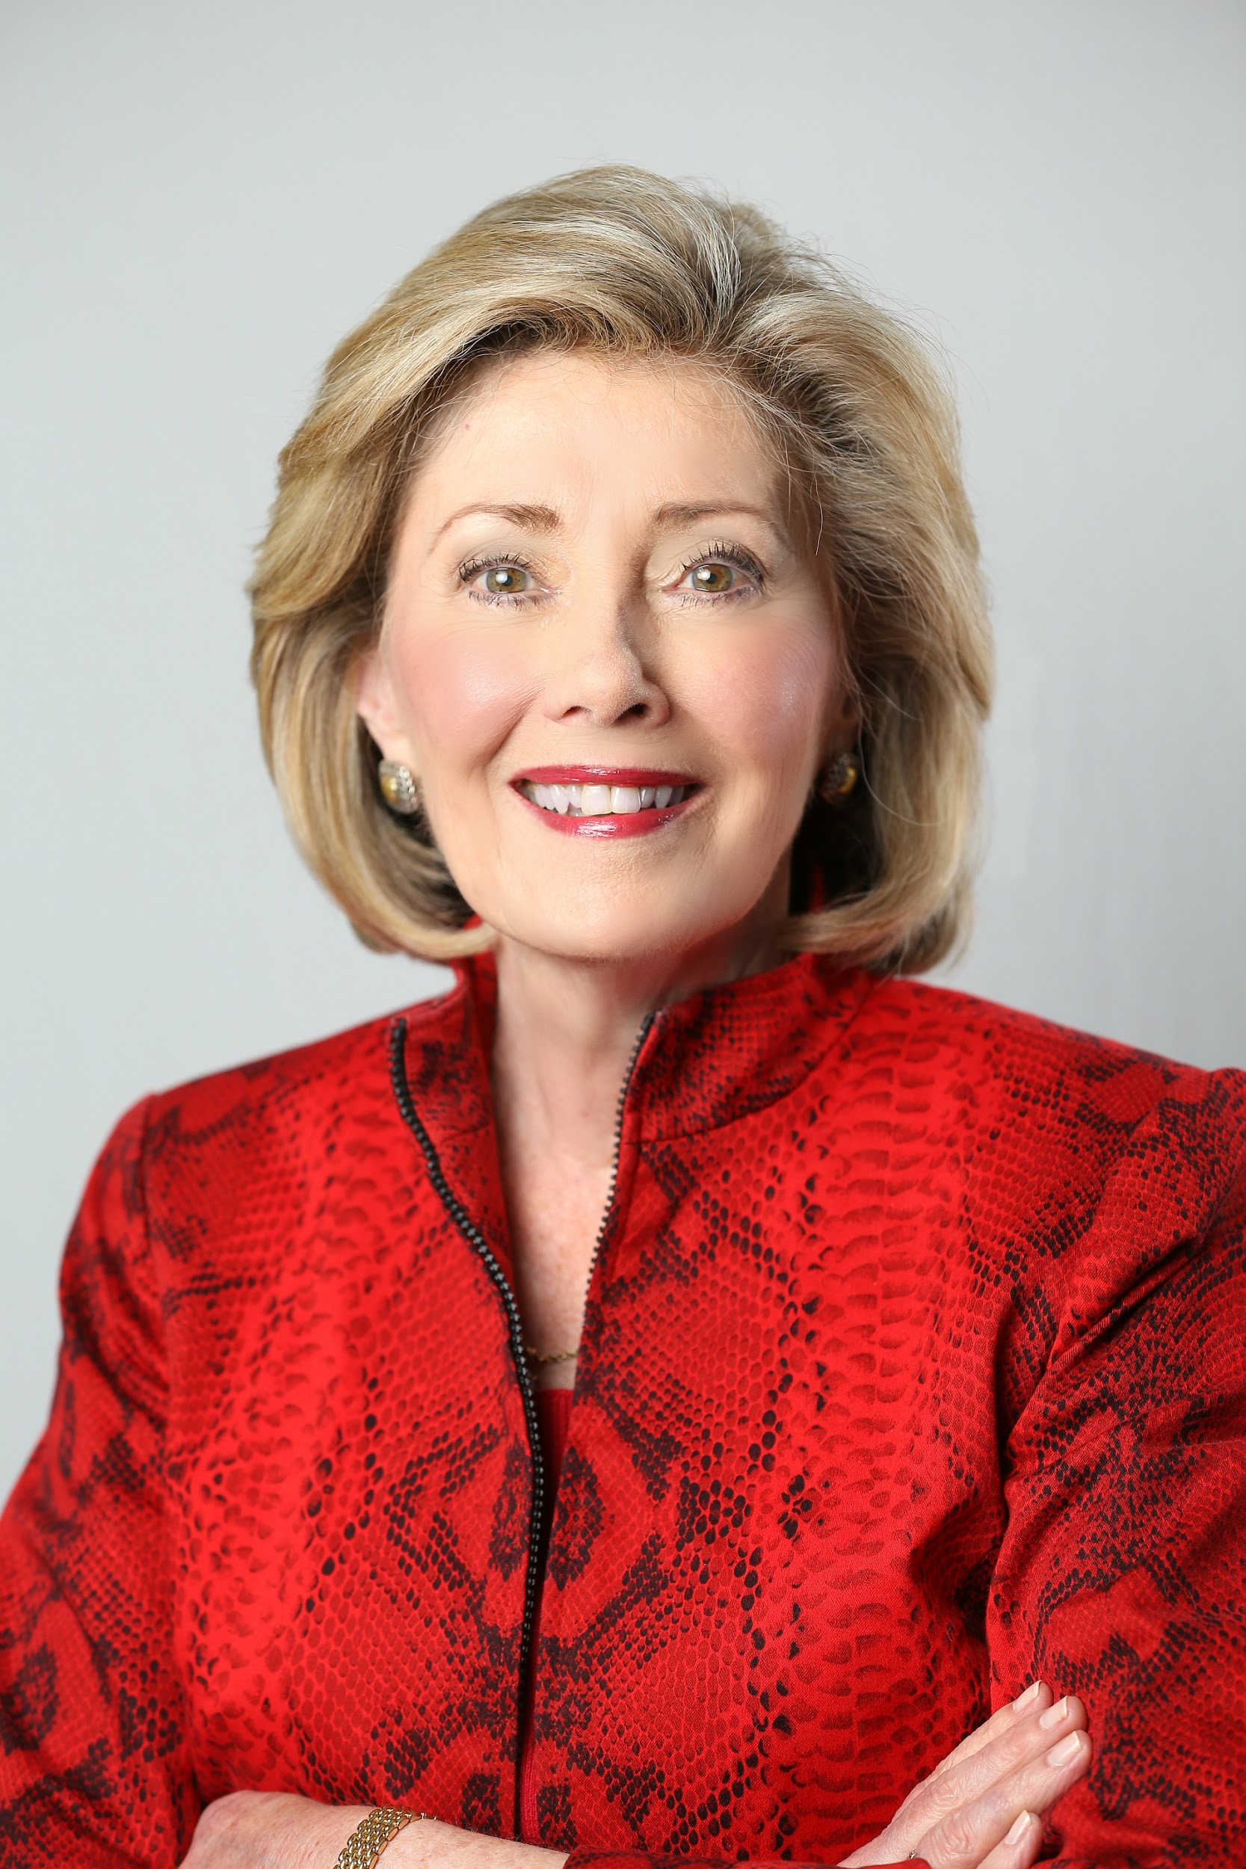
Paula Paust
Executive Director, The Women’s Home

Slide 34
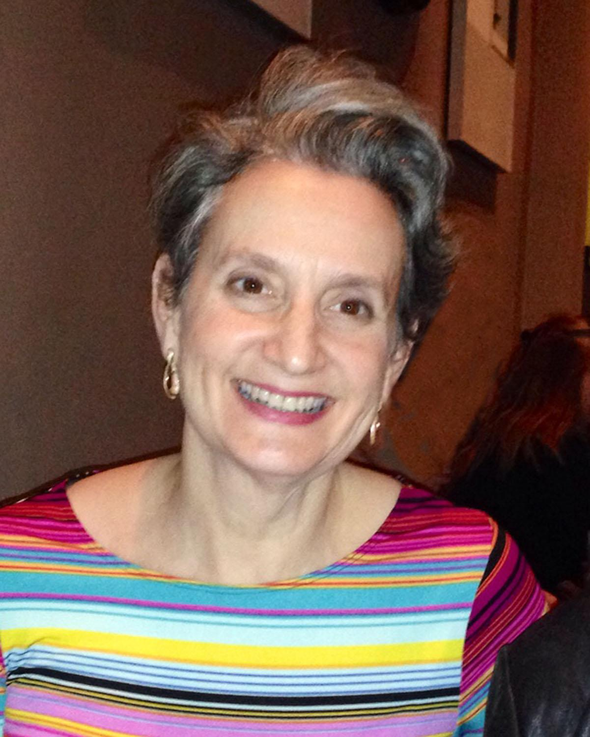
Barbara Radnofsky
Lawyer, Radnofsky Mediation Services

Slide 35
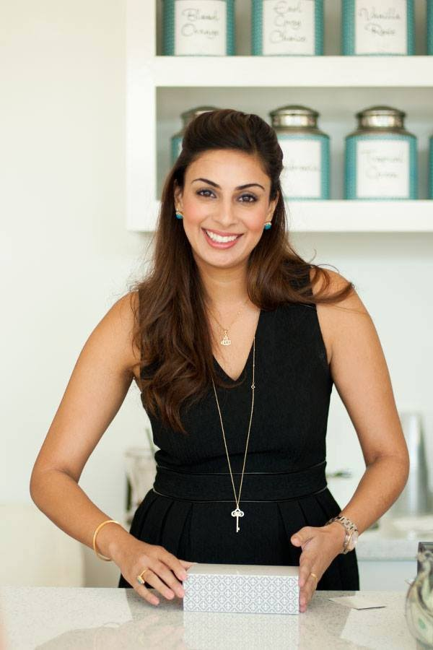
Sukaina Rajani
Co-Founder & Baker, MACARON by Patisse

Slide 36
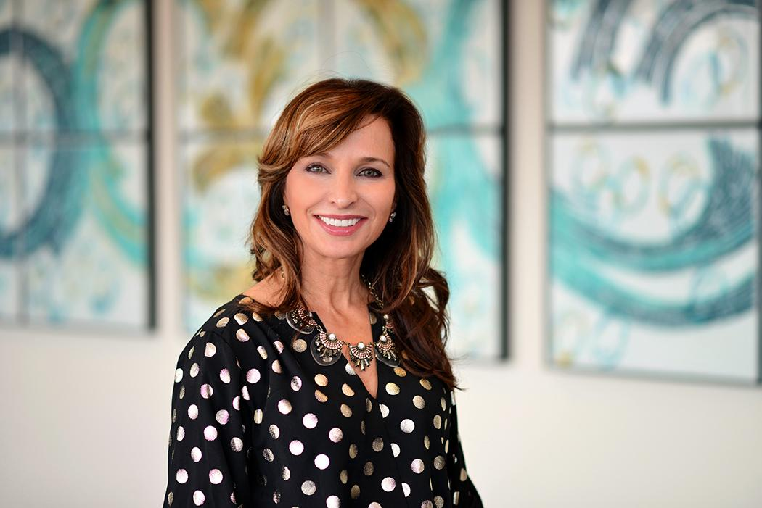
Mary Jo Rapini
Relationship Psychotherapist,
Mary Jo Rapini LPC

Slide 37
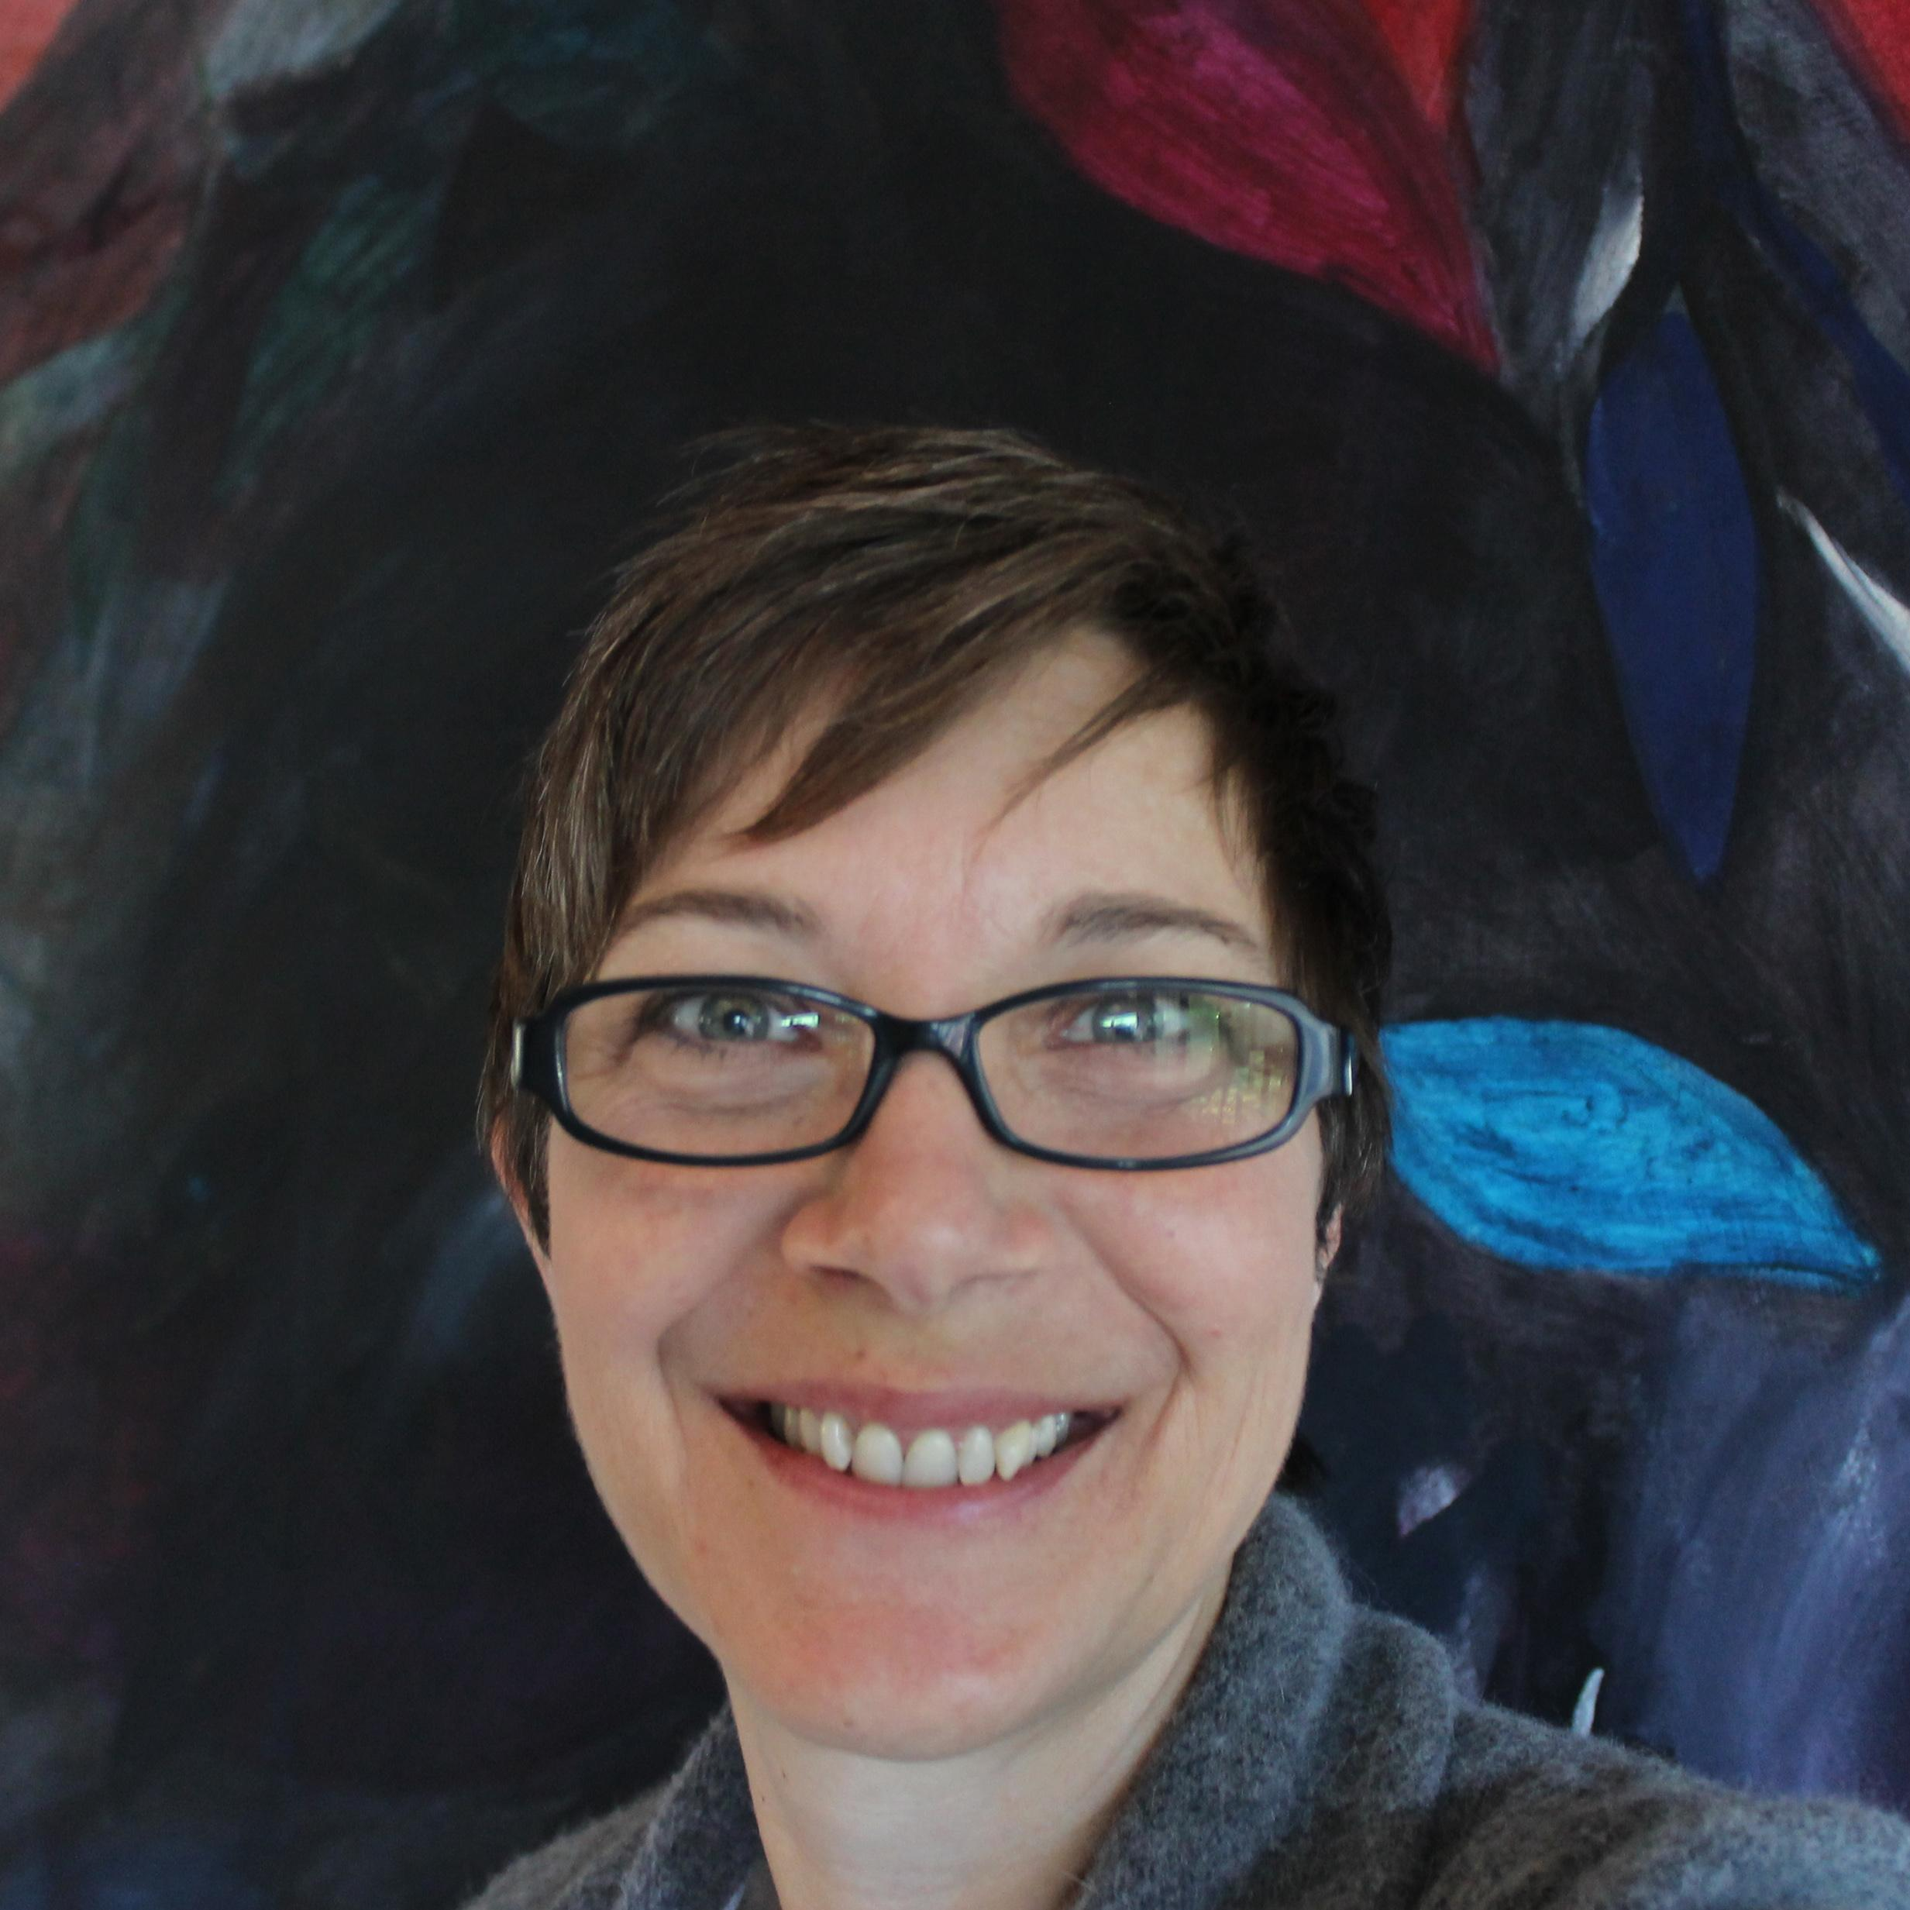
Susan Rogers
Associate Professor of Architecture, UH & Director, Community Design Resource Center

Slide 38
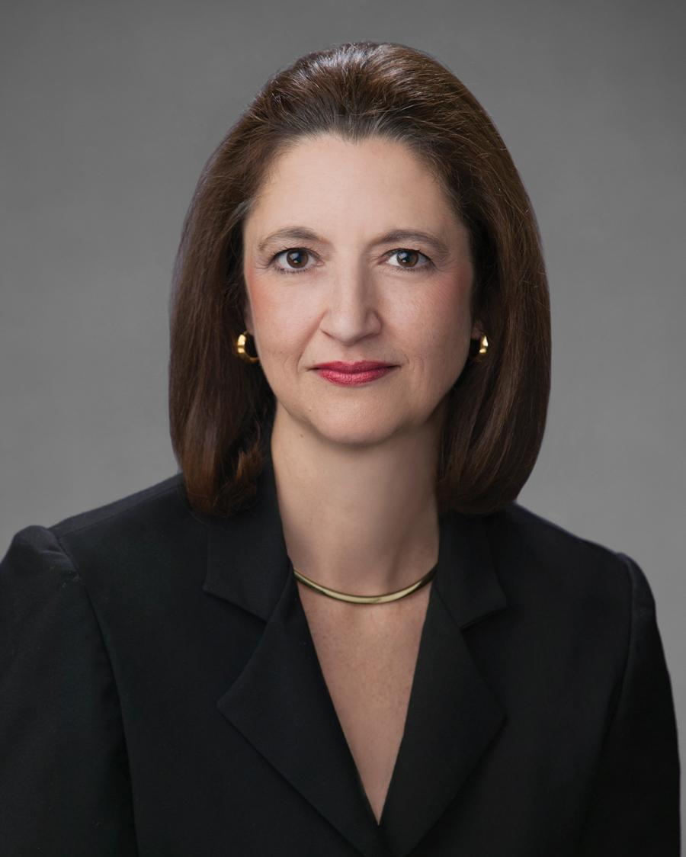
Robin Russell
Houston Office Managing Partner,
Andrews Kurth LLP

Slide 39
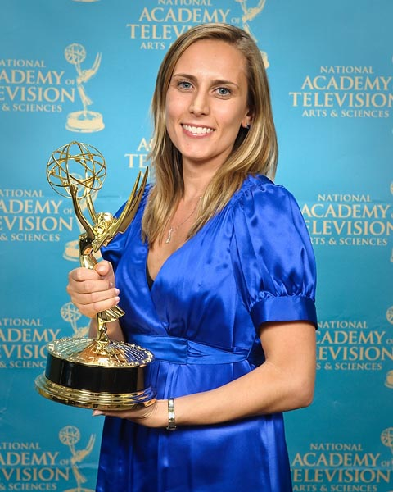
Allison Shigo
Executive Director & Founder,
Healing Hands of Joy

Slide 40
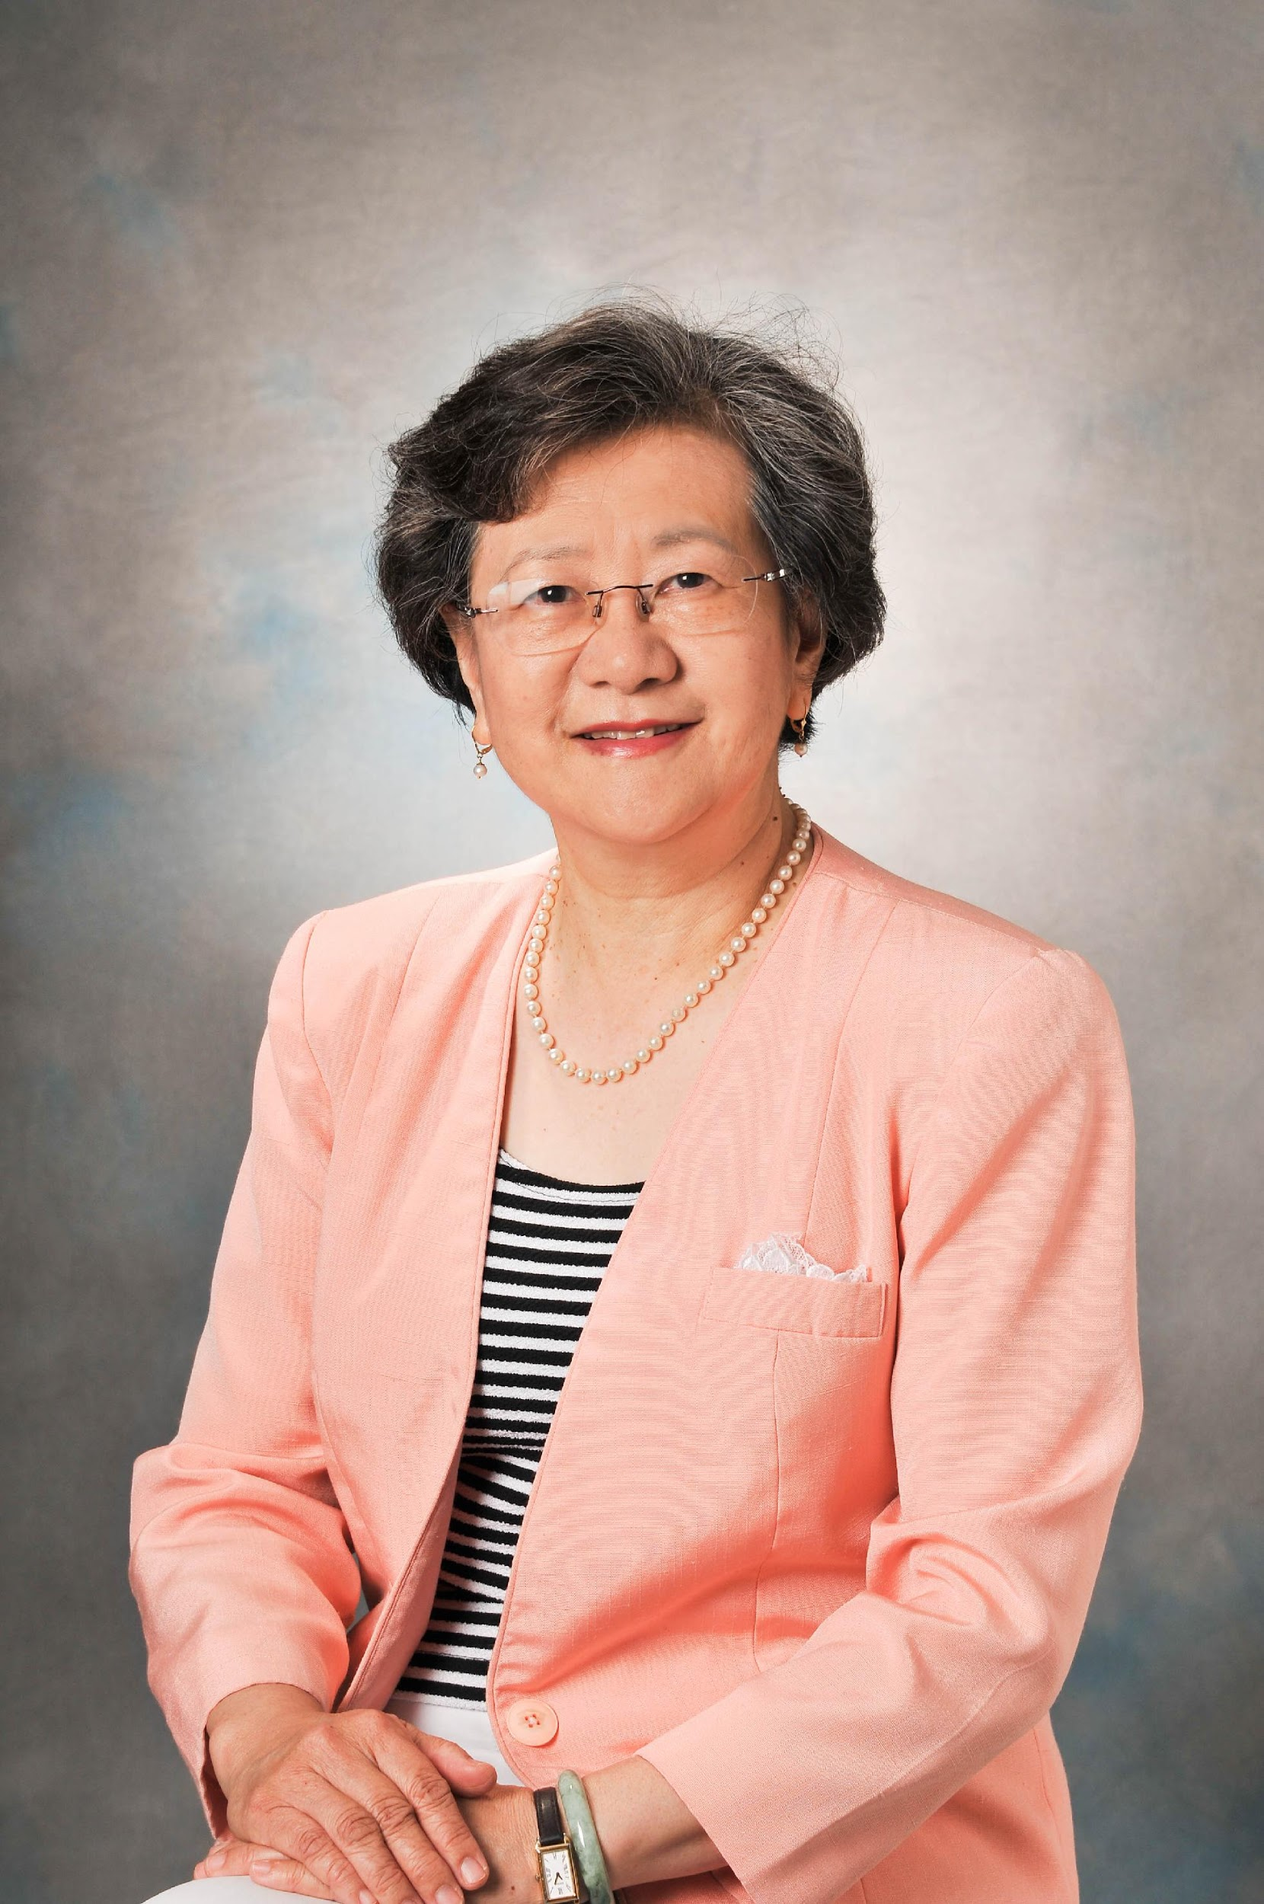
Diana Shu-Lian Chow, PhD
UH Professor of Pharmaceutics & Director of the Institute for Drug Education and Research

Slide 41
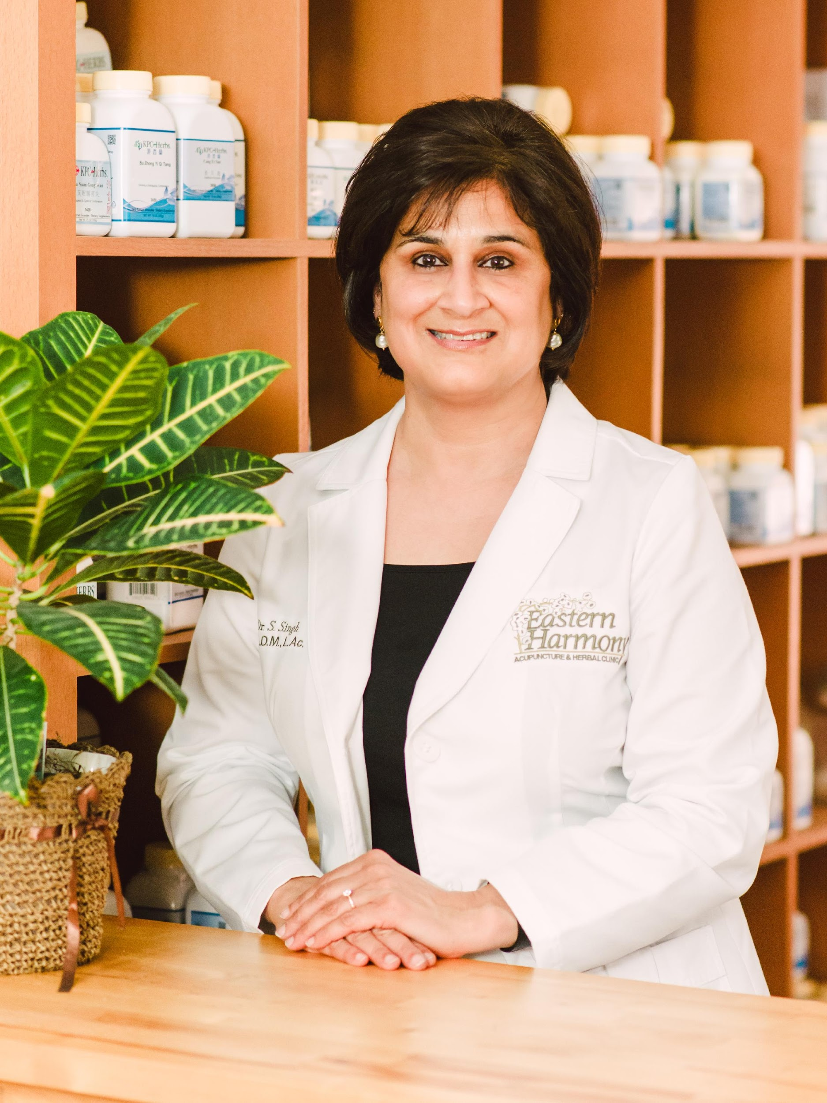
Sadnha Singh, DAOM
President, Eastern Harmony Clinic

Slide 42
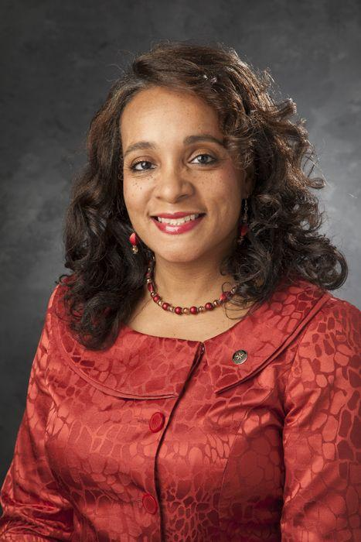
Rhonda Skillern-Jones
President, HISD Board of Education

Slide 43
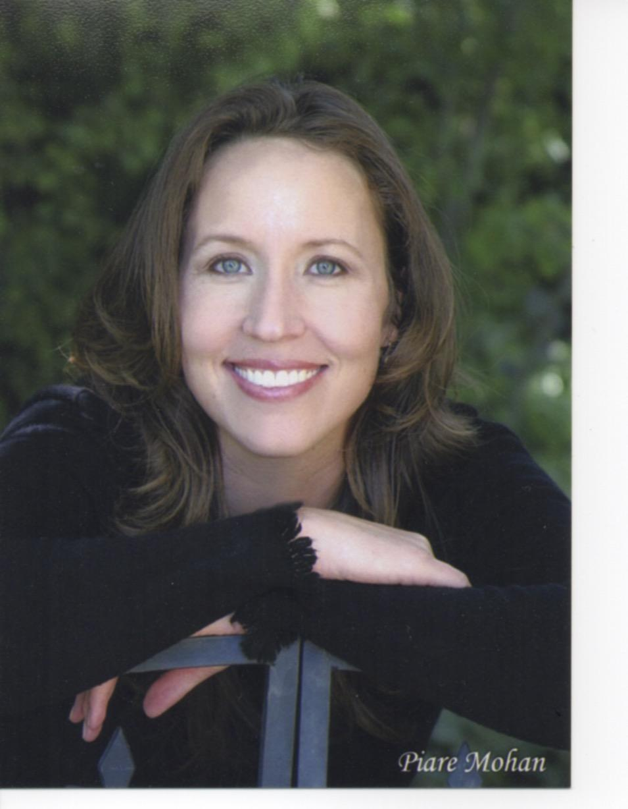
Kristi Taylor
Captain, Houston Pilots, Houston Ship Channel

Slide 44
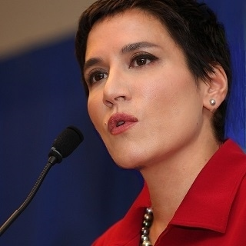
Terzah Tippin Poe
Partner, TRIO Global Solutions

Slide 45
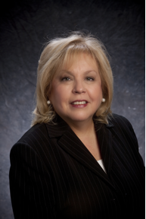
Linda Trevino
Senior Stakeholder Affairs Representative, Metropolitan Transit Authority

Slide 46
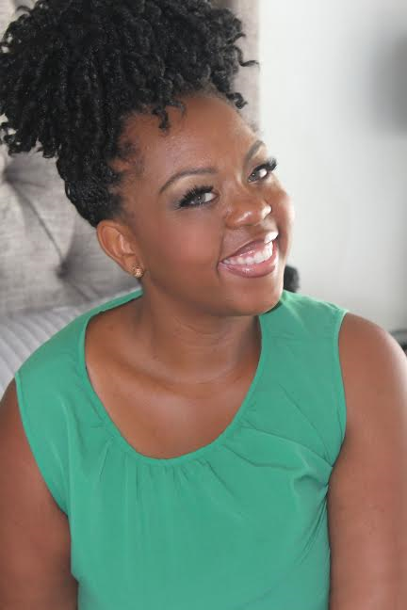
Ashley Turner
Chief Operating Officer, Bee Busy Wellness Center & Houston First Lady

Slide 47
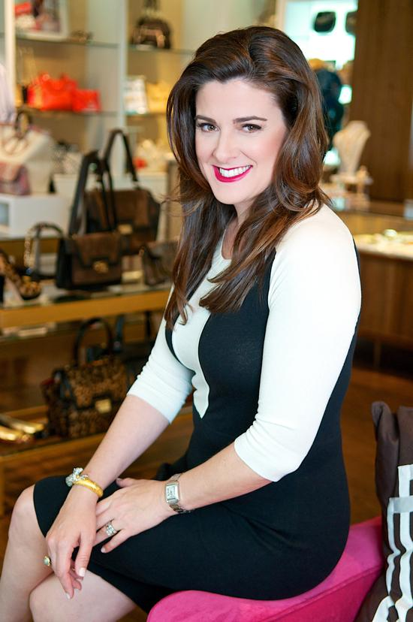
Elaine Turner
Owner & Designer, Elaine Turner

Slide 48
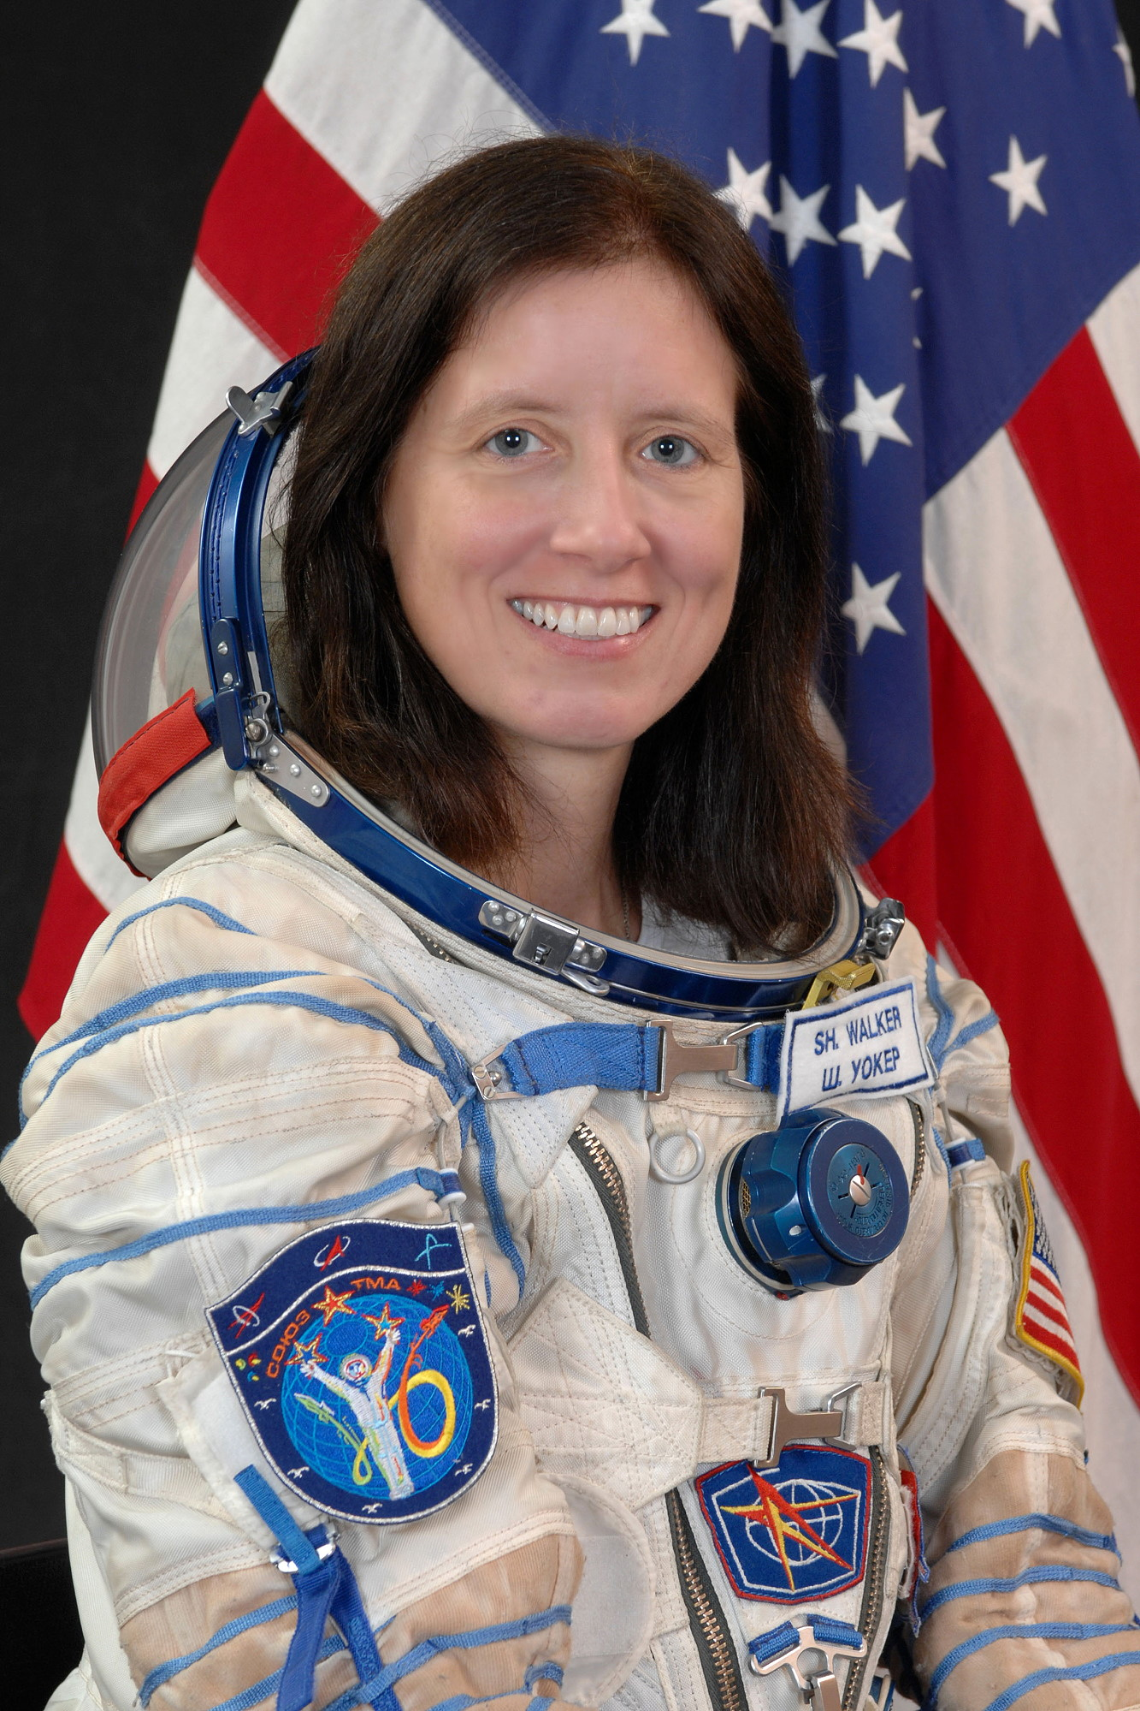
Shannon Walker, PhD
Astronaut, Johnson Space Center

Slide 49
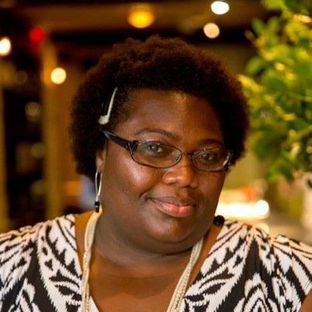
Fran Watson
Partner, Simoneaux & Watson PC

Slide 50
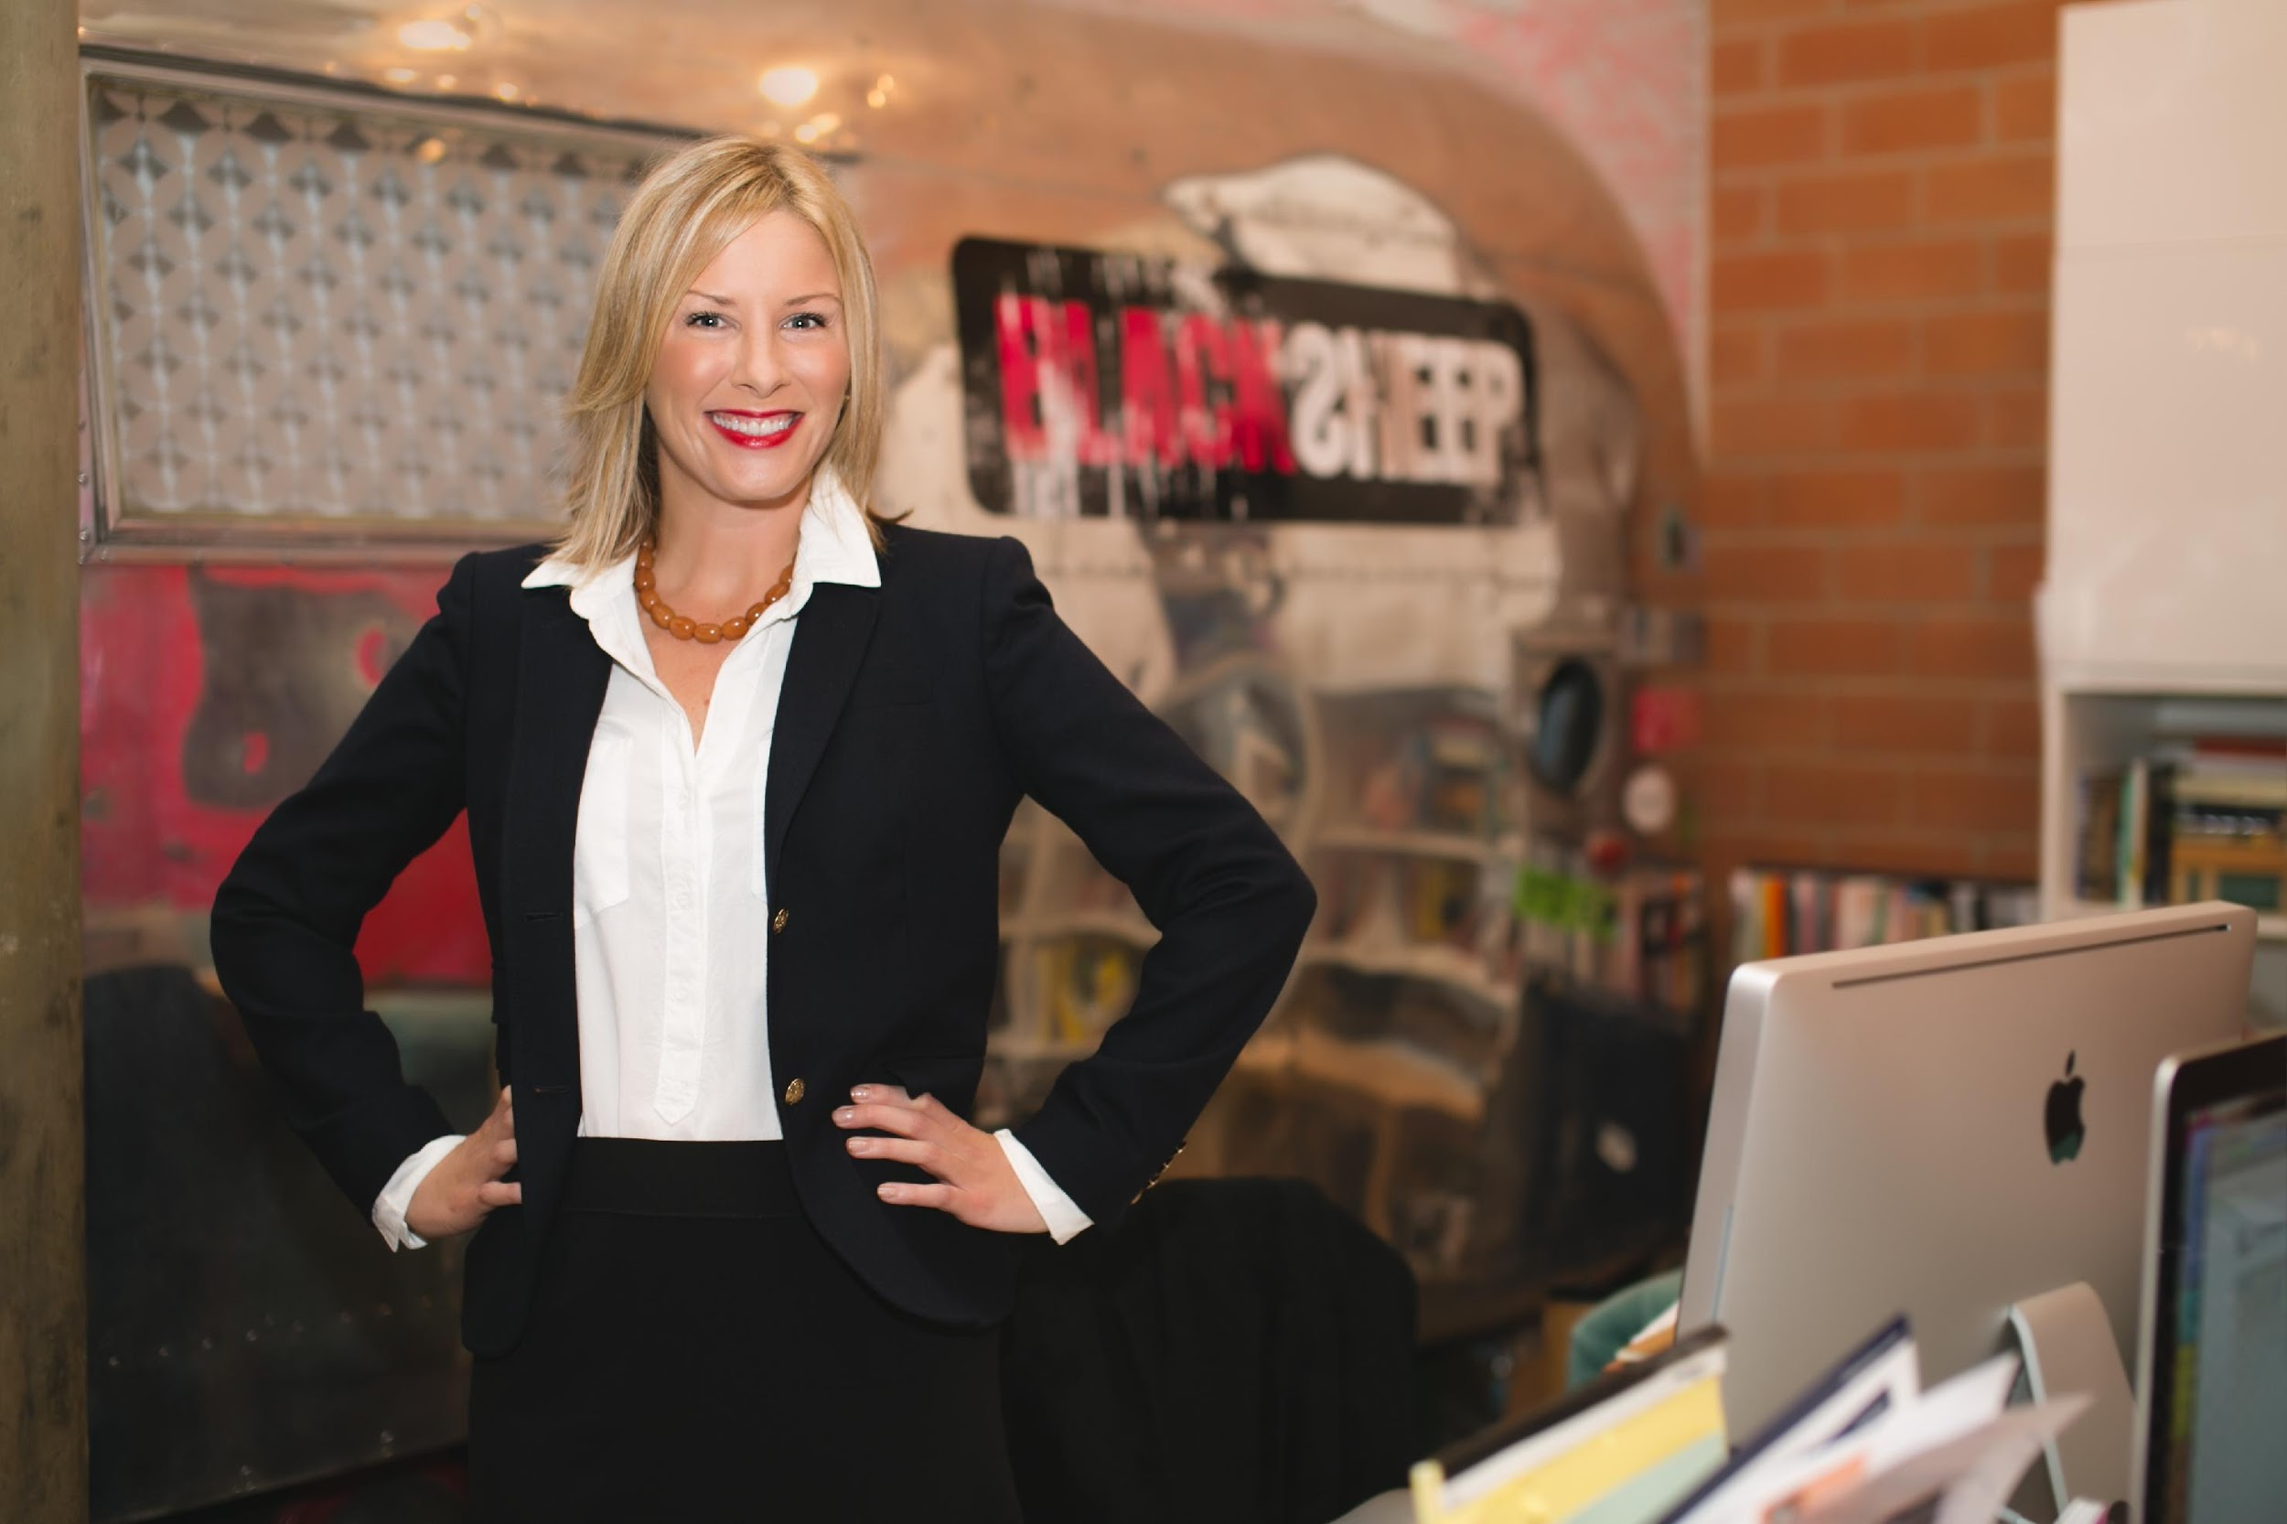
Aimee Woodall
Owner & Founder, The Black Sheep Agency

Slide 51

Courtney Wyckoff
CEO & Founder, Momma Strong

